Slide 1
EPUB 3 is live and running
Digital Publishing Summit, June 2019, Paris
Luc Audrain
Head of Digitalization, Hachette Livre
W3C Publishing Business Group co-chair

Slide 2
EPUB : a living standard
A worldwide contribution
2006 to 2016 in IDPF
Since 2017 in W3C
2006
2011
2015
2017
2019
EPUB 2
EPUB 3.0 (+ some of EPUB 3.1)
EPUB 3.0
EPUB 3.1
EPUB 3.2
Specifications
IDPF: International Digital Publishing Forum
W3C: World Wide Web Consortium

Slide 3
How W3C Publishing Activity is Organized
Digital Publishing Summit
Europe, Berlin, May 2018
Digital Publishing Summit
Europe, Paris, June 2019
Japan Publishing Event
Sept. 2019

Slide 4
EPUB 3.2 MOTIVATIONS
Strong backward compatibility — all* EPUB 3.0.1 files should be valid EPUB 3.2 files
Take the good stuff from 3.1
Make spec easier to read
Allow EPUB to evolve with the web
New HTML like <details>
New CSS like flexbox
Fix validation issues around epub:type
*ish

Slide 5
EPUB 3.2 CHANGES FROM EPUB 3.0.1
Undated, evolving references to HTML5, CSS, and SVG.
EPUB will improve along with the web.
New core media types (WOFF2, SFNT)
Much cleanup of spec language and organization
Deprecating bindings, switch, trigger
Add EPUB Accessibility spec
No restrictions on epub:type

Slide 6
EPUB today, by specification
Universal
All kind of books
One file for all
Conformant
Open and free specification from largest standardization bodies
Files conformity checkable with EPUBCheck
Interoperable
Distributed by all vendors
Runs on every e-Reader, tablet, application
Accessible
With well specified HTML coding techniques
Promoted by visually impaired people worldwide organizations

Slide 7
EPUB today, implementation issues
Universal
Not all publications : scholarly, audiobooks
Fixed Layout is an issue for small devices and accessibility
Conformant
Some process produce non conformant files on big markets
Compromise in checking : warnings instead of errors
Interoperable
Old legacy e-Readers may need additional backward compatibility
Some reading system issues needing specific adaptations
Accessible
Image description is a huge issue for publishers
EPUB to Kindle conversion may loose some quality on accessibility

Slide 8
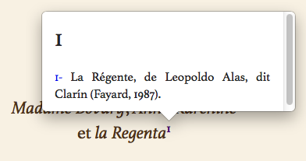
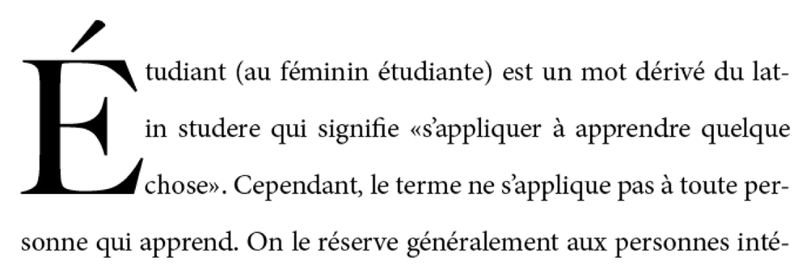
Reminder on EPUB 3 features
Up to date Web technologies
Accessibility
Improved user experience
Improved typography
MathML

Slide 9
With CSS 3: responsive for complex layout

Slide 10
EPUBCheck : the tool everyone needs
Publishing Business Group concerns:
No update since summer 2016
Find a development organization
Find money : international fundraising call
Development : DAISY Consortium
Fix 4.1 bugs : 4.1.1 published in January 2019
Check EPUB 3.2 :
Improving the specification wording with the EPUB3 CG
4.2 published in May 2019
Future Work still needs funding
Documentation, overhaul the test suite to enable easier contribution
https://www.w3.org/publishing/epubcheck_fundraising

Slide 11
Quotes
Most content creators will not have to change anything. Your EPUBs are likely already valid EPUB 3.2 files.
Dave Cramer in “What's New in EPUB 3.2?"
https://bisg.org/news/455963/Whats-New-in-EPUB-3.2.htm, June 14th, 2019
EPUB 3.2 moves the standard back in line with the Web’s evolving nature.
Matt Garrish in “EPUB 3.2—Back to the Future of the Web."
https://inclusivepublishing.org/blog/epub-3-2-back-to-the-future-of-the-web/, June 2nd, 2019

Slide 12
Farewell EPUB 2
In EPUB2 functional perimeter, EPUB3 does it better !
7 of the best reasons to why switch to EPUB 3:
1. Document structure and semantics
2. Enhanced typography
3. Better user experience
4. Support of any language
5. Accessibility Conformance Requirements
6. Rich Navigation
7. MathML Support
Adapting an existing EPUB2 process to generate EPUB3 is a no brainer.
12

Slide 13
PublishINg@W3C: how to Contribute
EPUB 3 Community Group
Technical Work to Advance EPUB 3 Capabilities
Co-Chairs
Rachel Comerford, Macmillan Learning
Dave Cramer, Hachette Book Group, USA
Free – everyone can participate
Publishing Business Group
Provides Strategic Direction, Business Focus
Co-Chairs :
Liisa McCloy-Kelley, Penguin Random House
Luc Audrain, Hachette Livre, France
Daihei Shiohama, MediaDo Japan
W3C Technical staff: Ivan Herman
Participation fee for W3C Business Groups - moderate

Slide 14
Useful resources
EPUB 3.2
Specs : http://w3c.github.io/publ-epub-revision/epub32/spec/epub-spec.html
Changes document : http://w3c.github.io/publ-epub-revision/epub32/spec/epub-changes.html
Publishing@W3C
Publishing Business Group: https://www.w3.org/publishing/groups/publ-bg/
EPUB3 Community Group: https://www.w3.org/community/epub3/
Publishing Working group: https://www.w3.org/publishing/groups/publ-wg/
EPUBCheck
Download latest version: https://github.com/w3c/epubcheck/releases
Funding: https://www.w3.org/publishing/epubcheck_fundraising

Slide 15
Thank you for your attention
laudrain@hachette-livre.fr

