Slide 1
Improving automatic image description in EPUB using Artificial Intelligence
Gregorio Pellegrino Chief Accessibility Officer

Slide 2
About me
Name: Gregorio Pellegrino
Nationality: Italian
City of residence: Turin (Juventus FC)
Education: Computer engineering
International Working Groups:
Publishing Working Group (W3C)
EPUB 3 (W3C)
Transition To accessible EPUB (DAISY)
Reading Systems (DAISY)
Work for: Fondazione LIA (Chief Accessibility Officer)

Slide 3
Fondazione LIA
Fondazione LIA is a non for profit organization promoting accessibility in the publishing field and was set up by AIE - Associazione Italiana Editori (Italian Association of Publishers) and UICI – Unione Italiana dei Ciechi e degli Ipovedenti (Italian Blind Union).
Its goal is to enable people with visual disability or those who struggle to read published printed products to choose how, when and above all what to read, thus fostering their social integration and active participation in the fields of culture, education and work.
The Foundation intends to, in particular:
promote reading and expand access for visual impaired people to publishing products through research and technological innovation;
spread a culture of accessibility through consulting and training involving all the actors of the supply-chain: such as publishers distributors, booksellers, manufacturers of e-reading solutions HW and SW;
deliver training for users in the field of digital reading.

Slide 4
A research project
This is a pilot project of Research and Development, not yet mature for production.
Realized in collaboration with the University of Siena, with the contribution of Tommaso Dringoli (master student)
It is a first experiment of using Image Recognition algorithms in publishing
The images used in publishing world have a much higher level of complexity
The solutions actually used in other industries (for example Social Network) are not detailed enough on their own.
For example, the available tools work well to describe photographs, but they have difficulties with illustrations, graphics and icons.

Slide 5
The importance of alternative descriptions

Slide 6
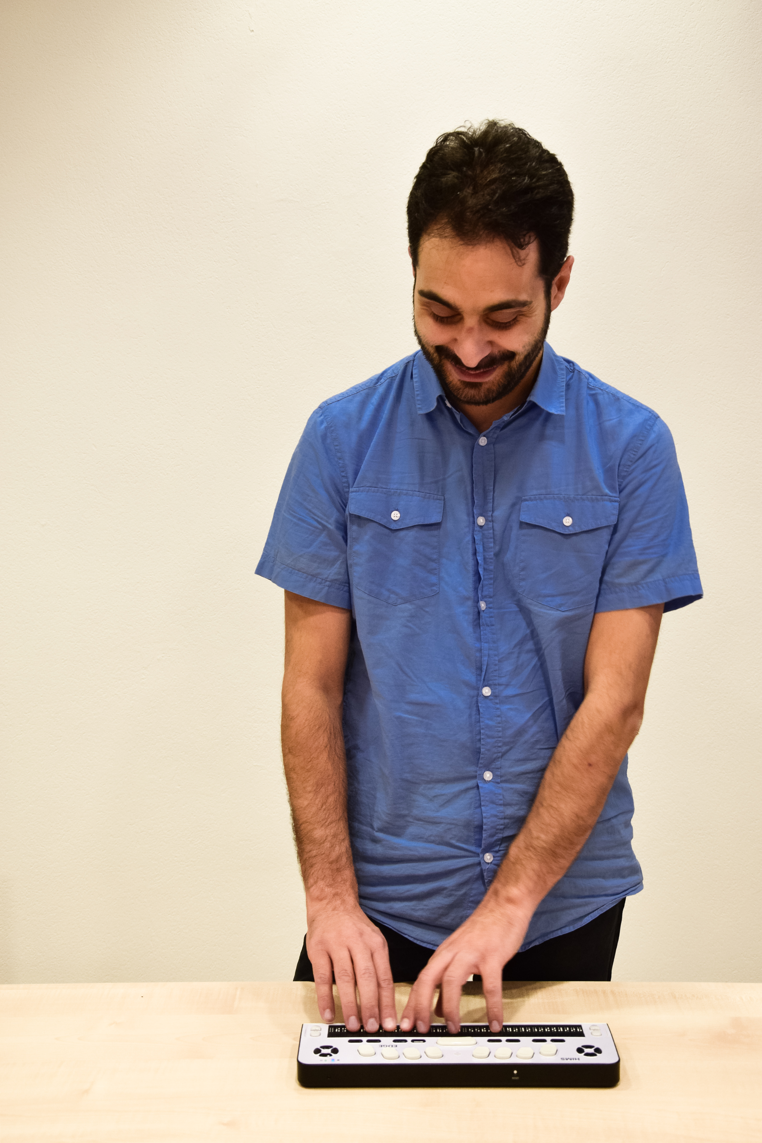
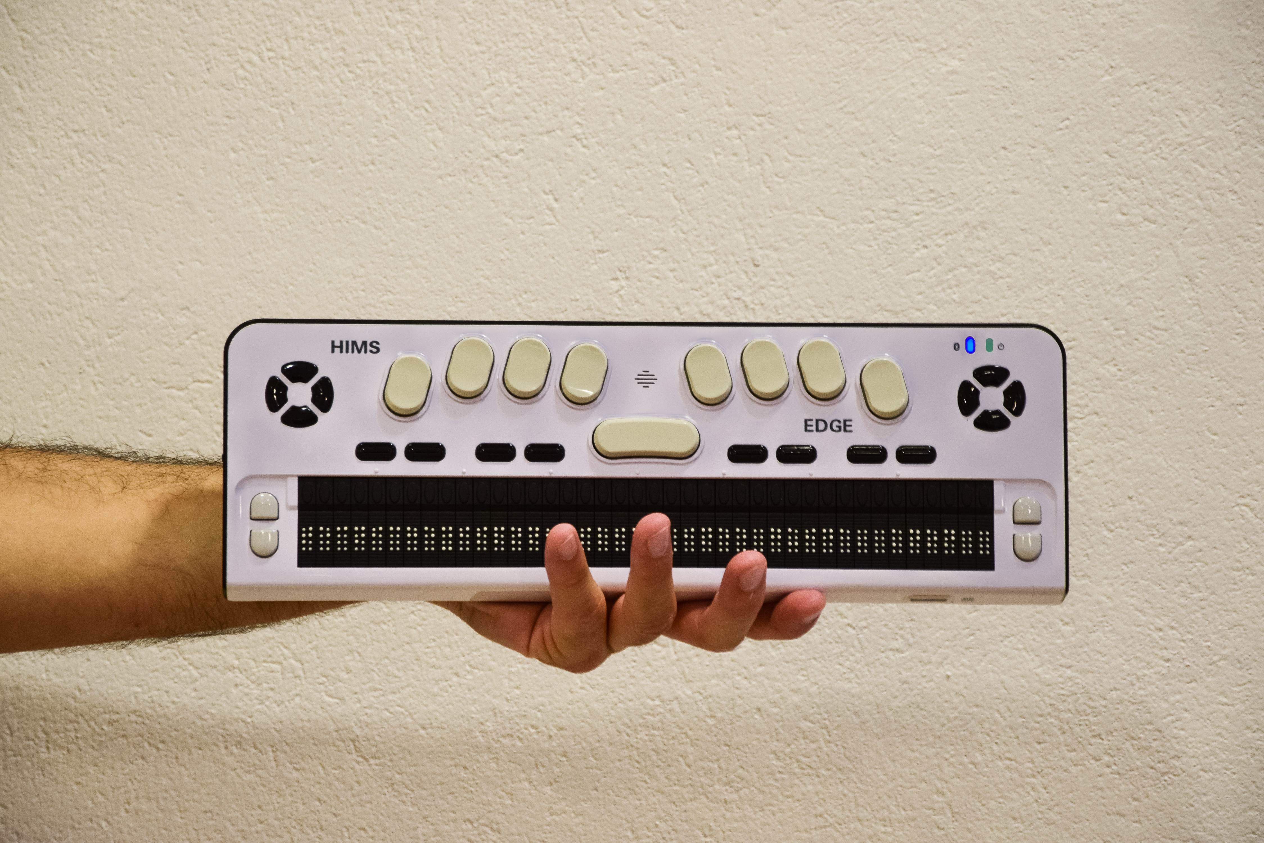

Slide 7
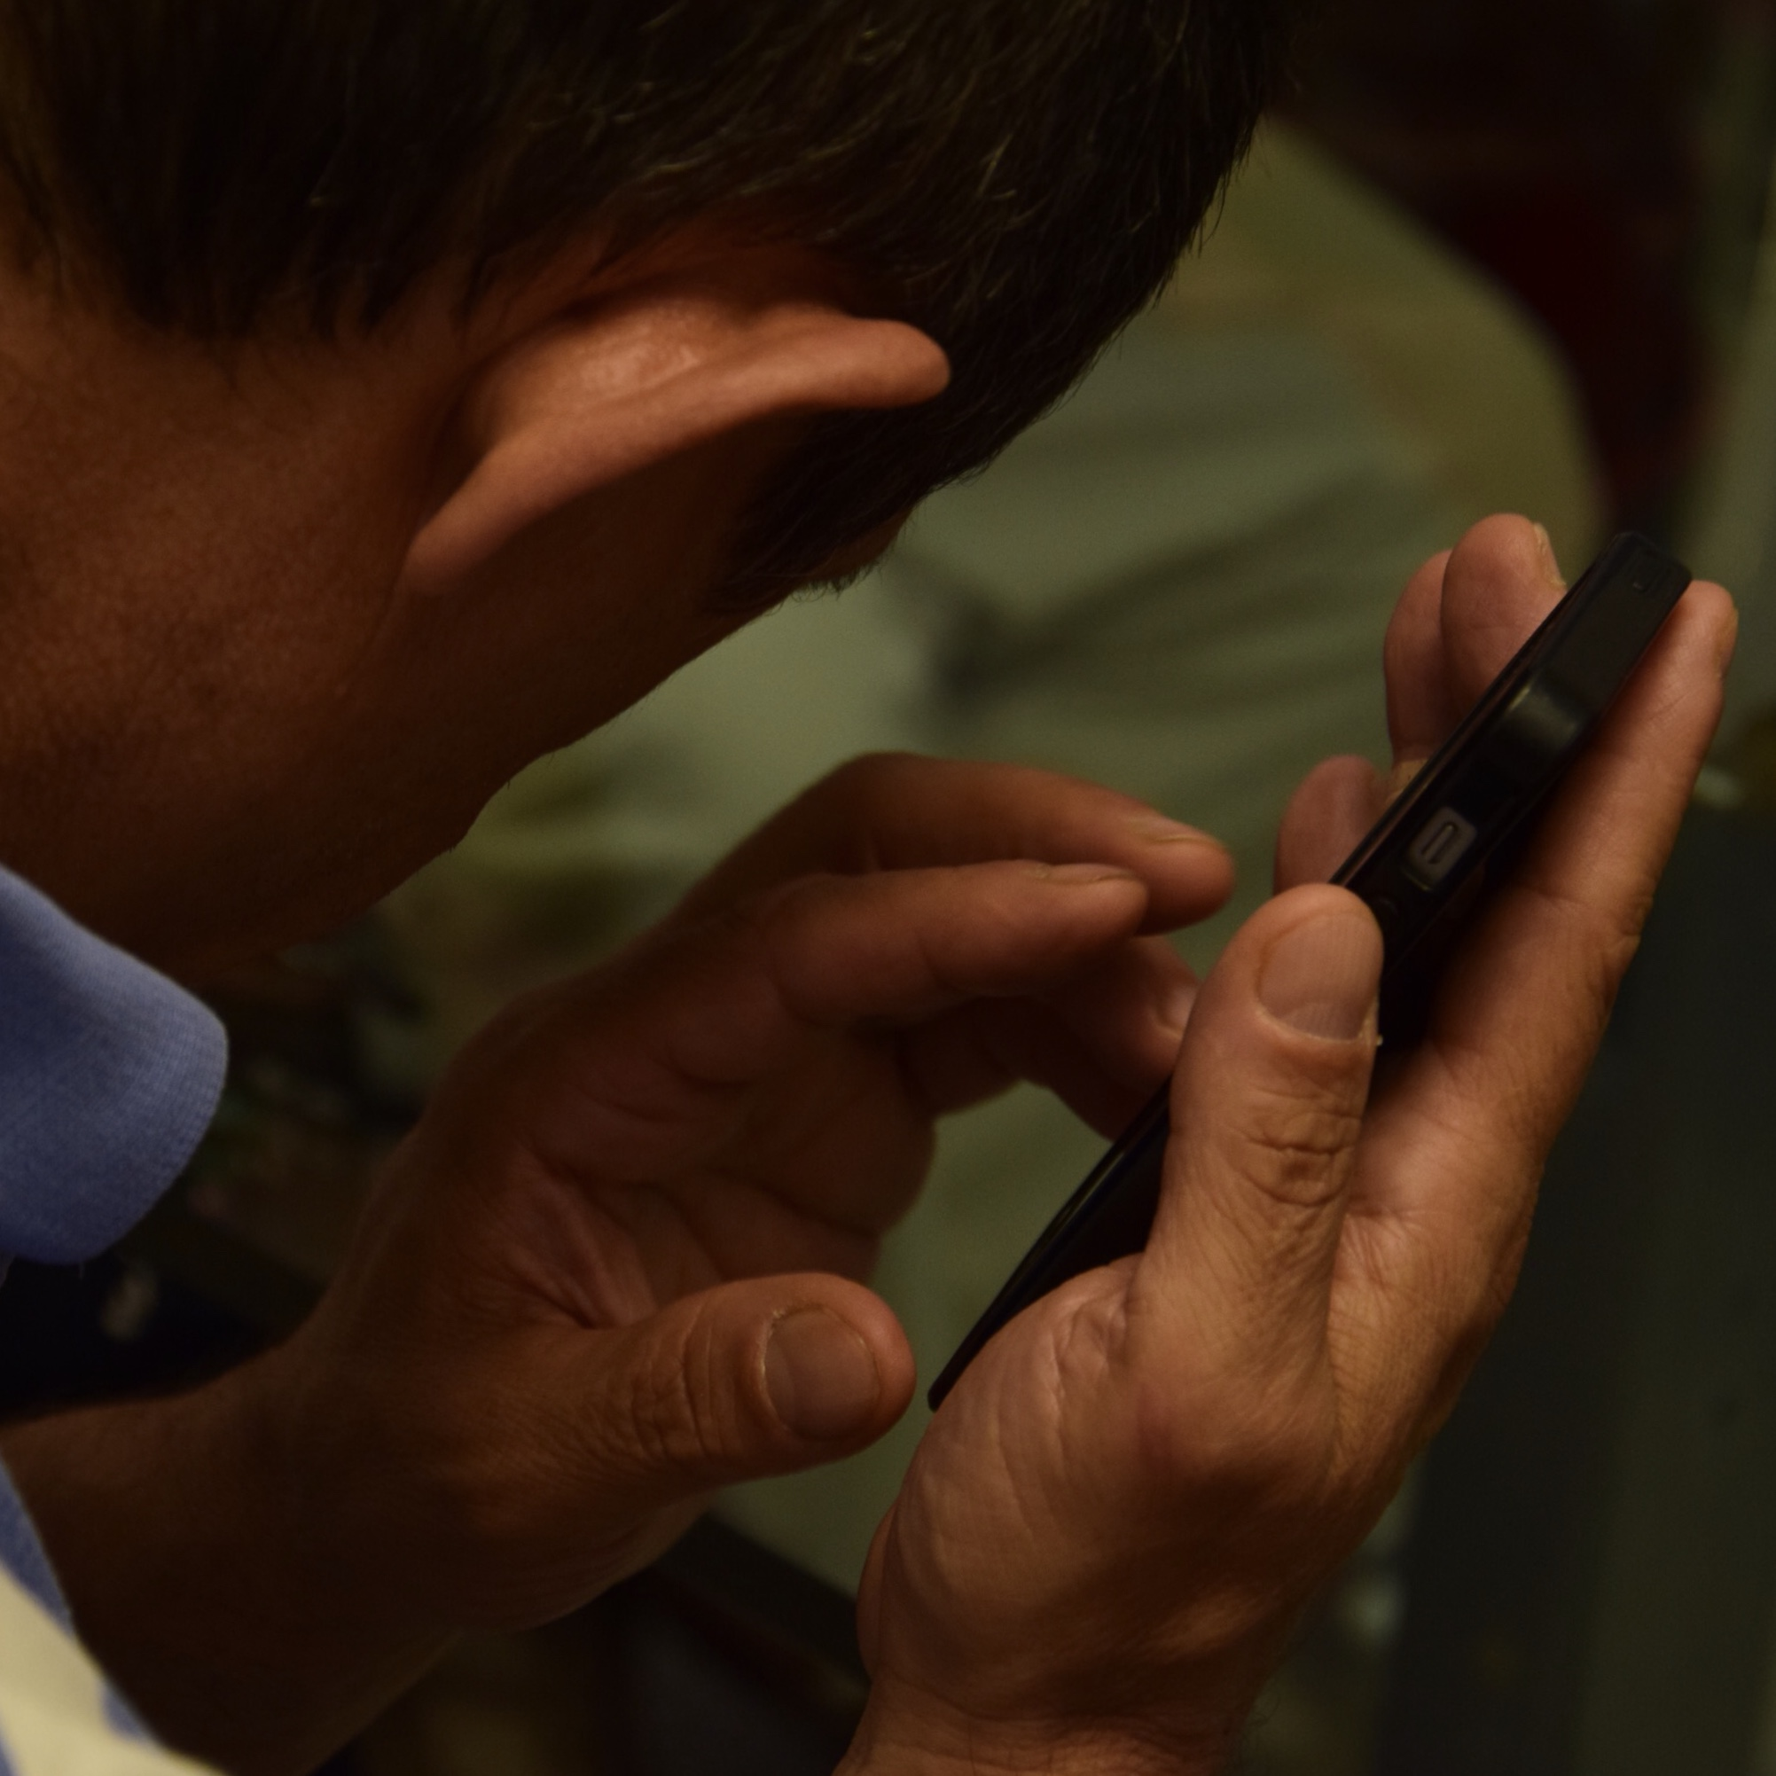
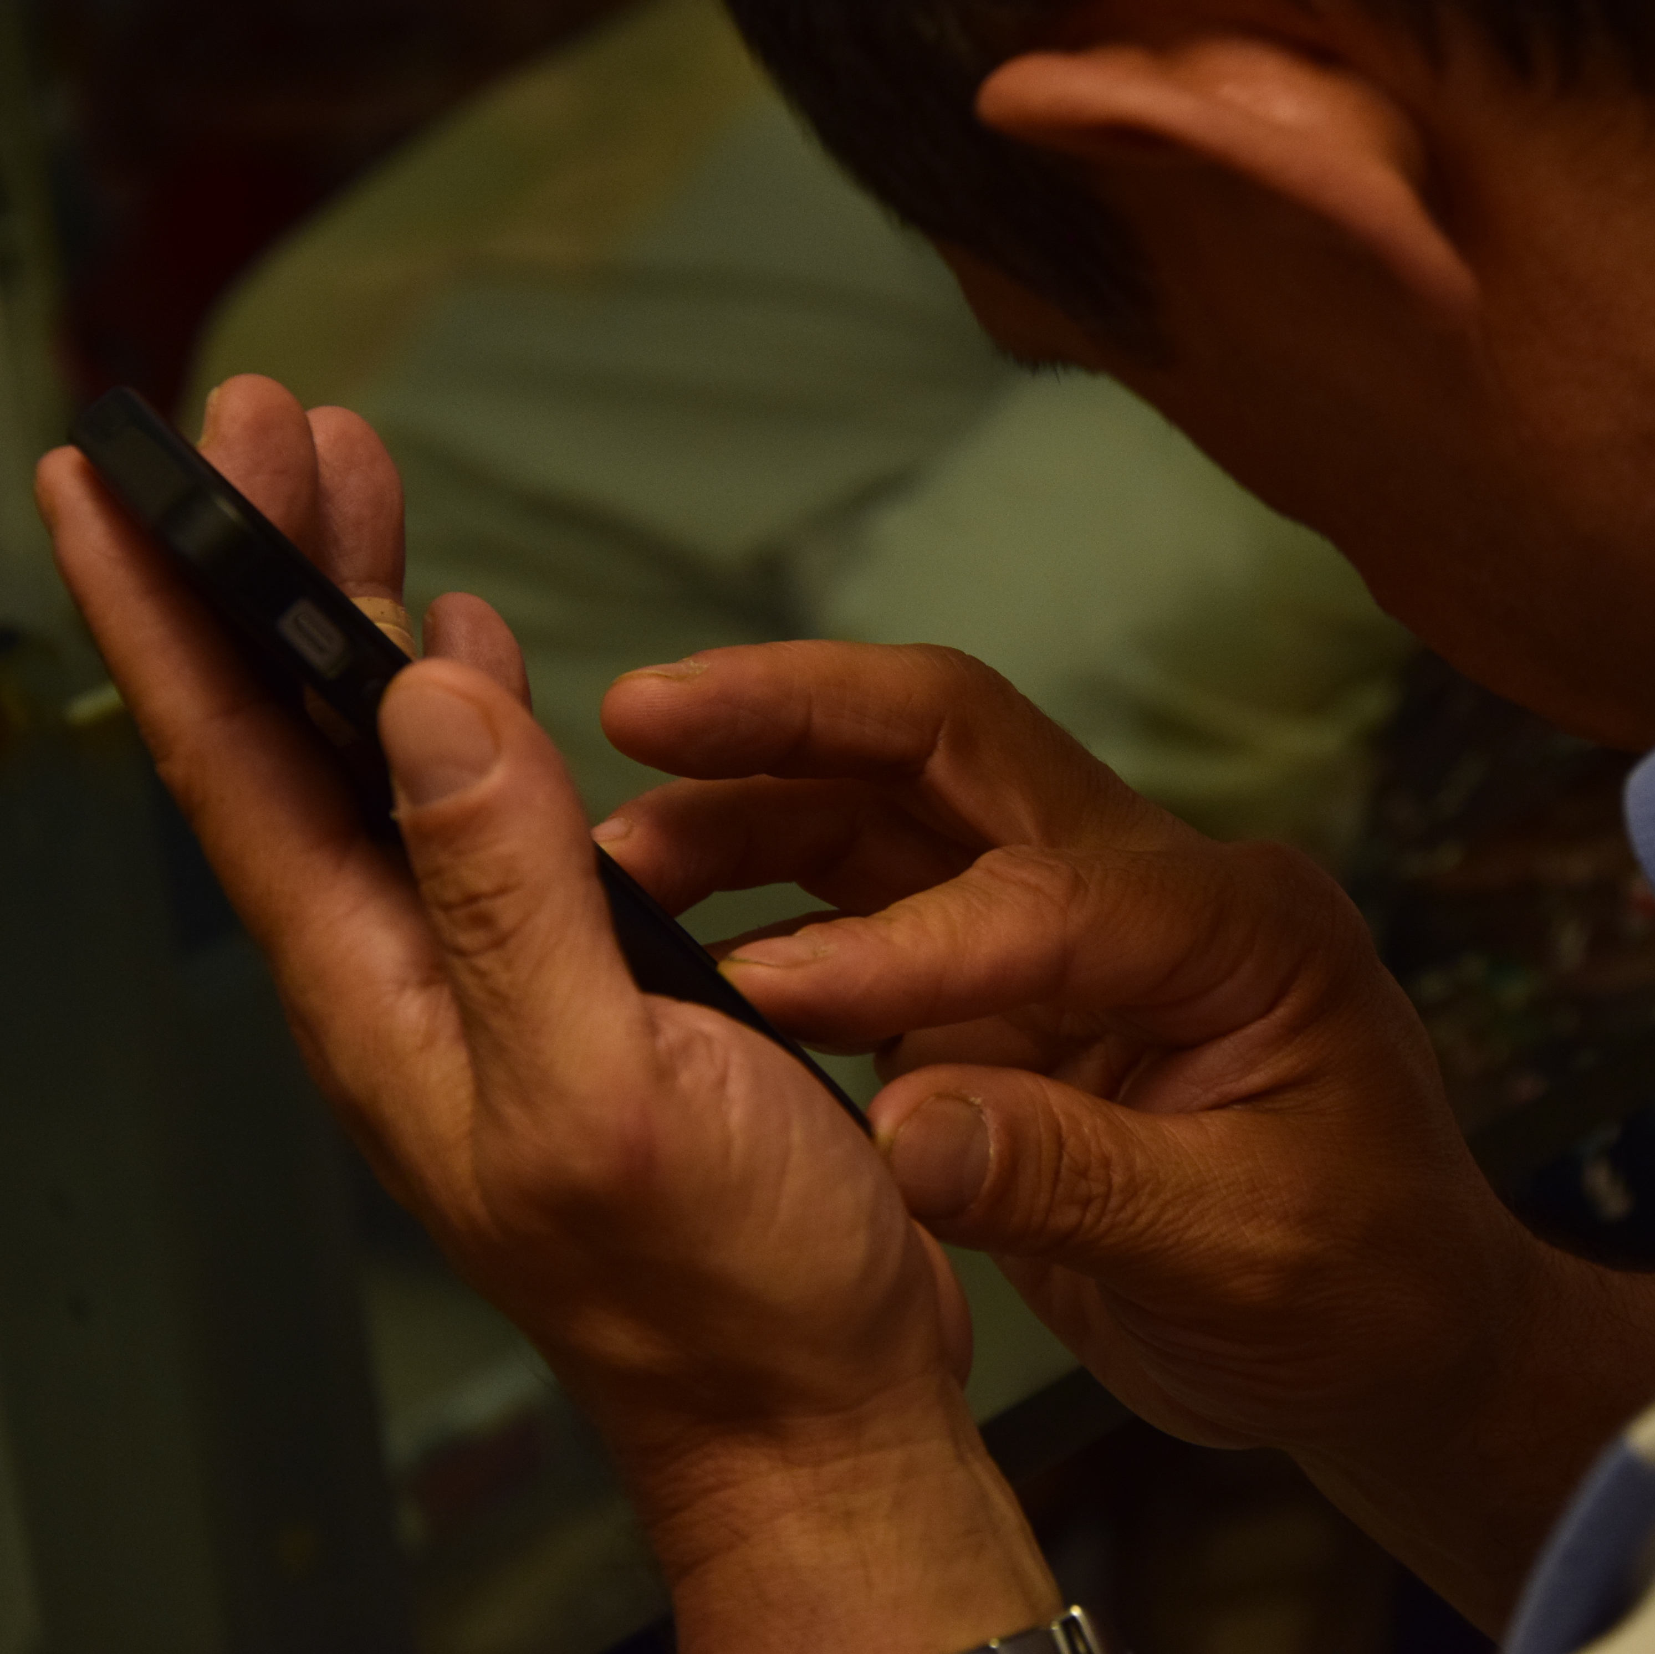

Slide 8
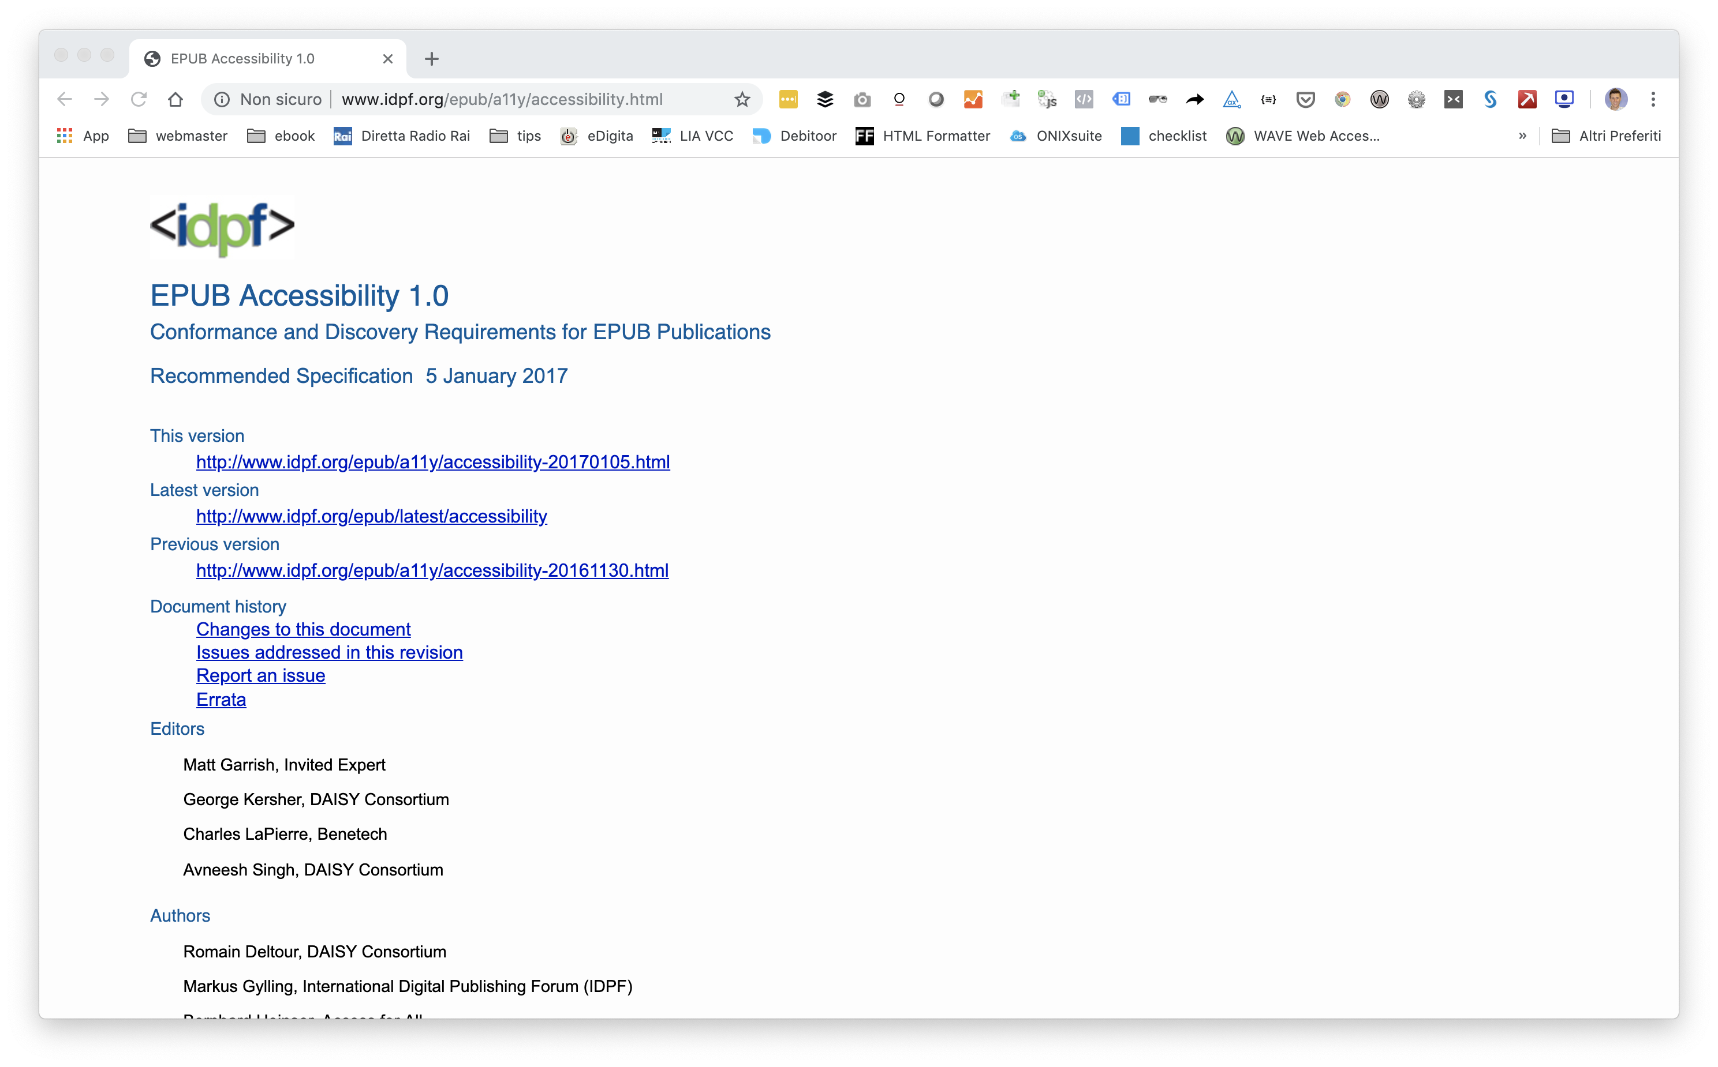
Requirements for creating accessible EPUBs
“In the case of image content, the provision of alternative text (e.g., in an HTML alt attribute) is sufficient for meeting the requirements of the EPUB Accessibility specification.”

Slide 10
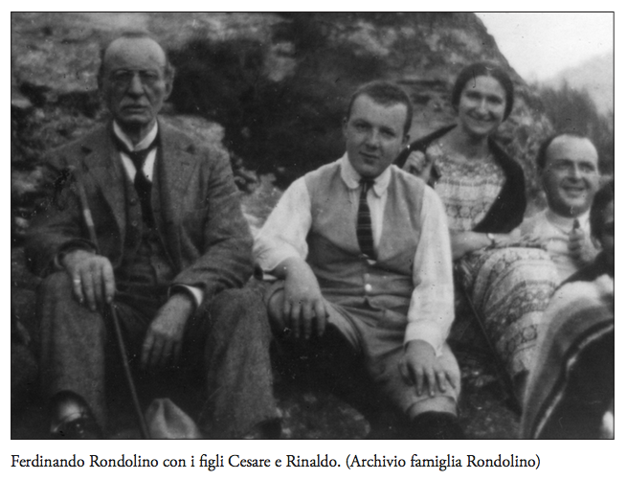
Alternative description ≠ caption
Ferdinando with his sons Cesare and Rinaldo. (© Rondolino Family Archive)

Slide 11
How an editor spends his or her working time
Notes:
Very expensive in terms of time and costs
Needs a specific know-how

Slide 12
Alternative description according to LIA
image category
description of the image

Slide 13
The AI solution

Slide 14
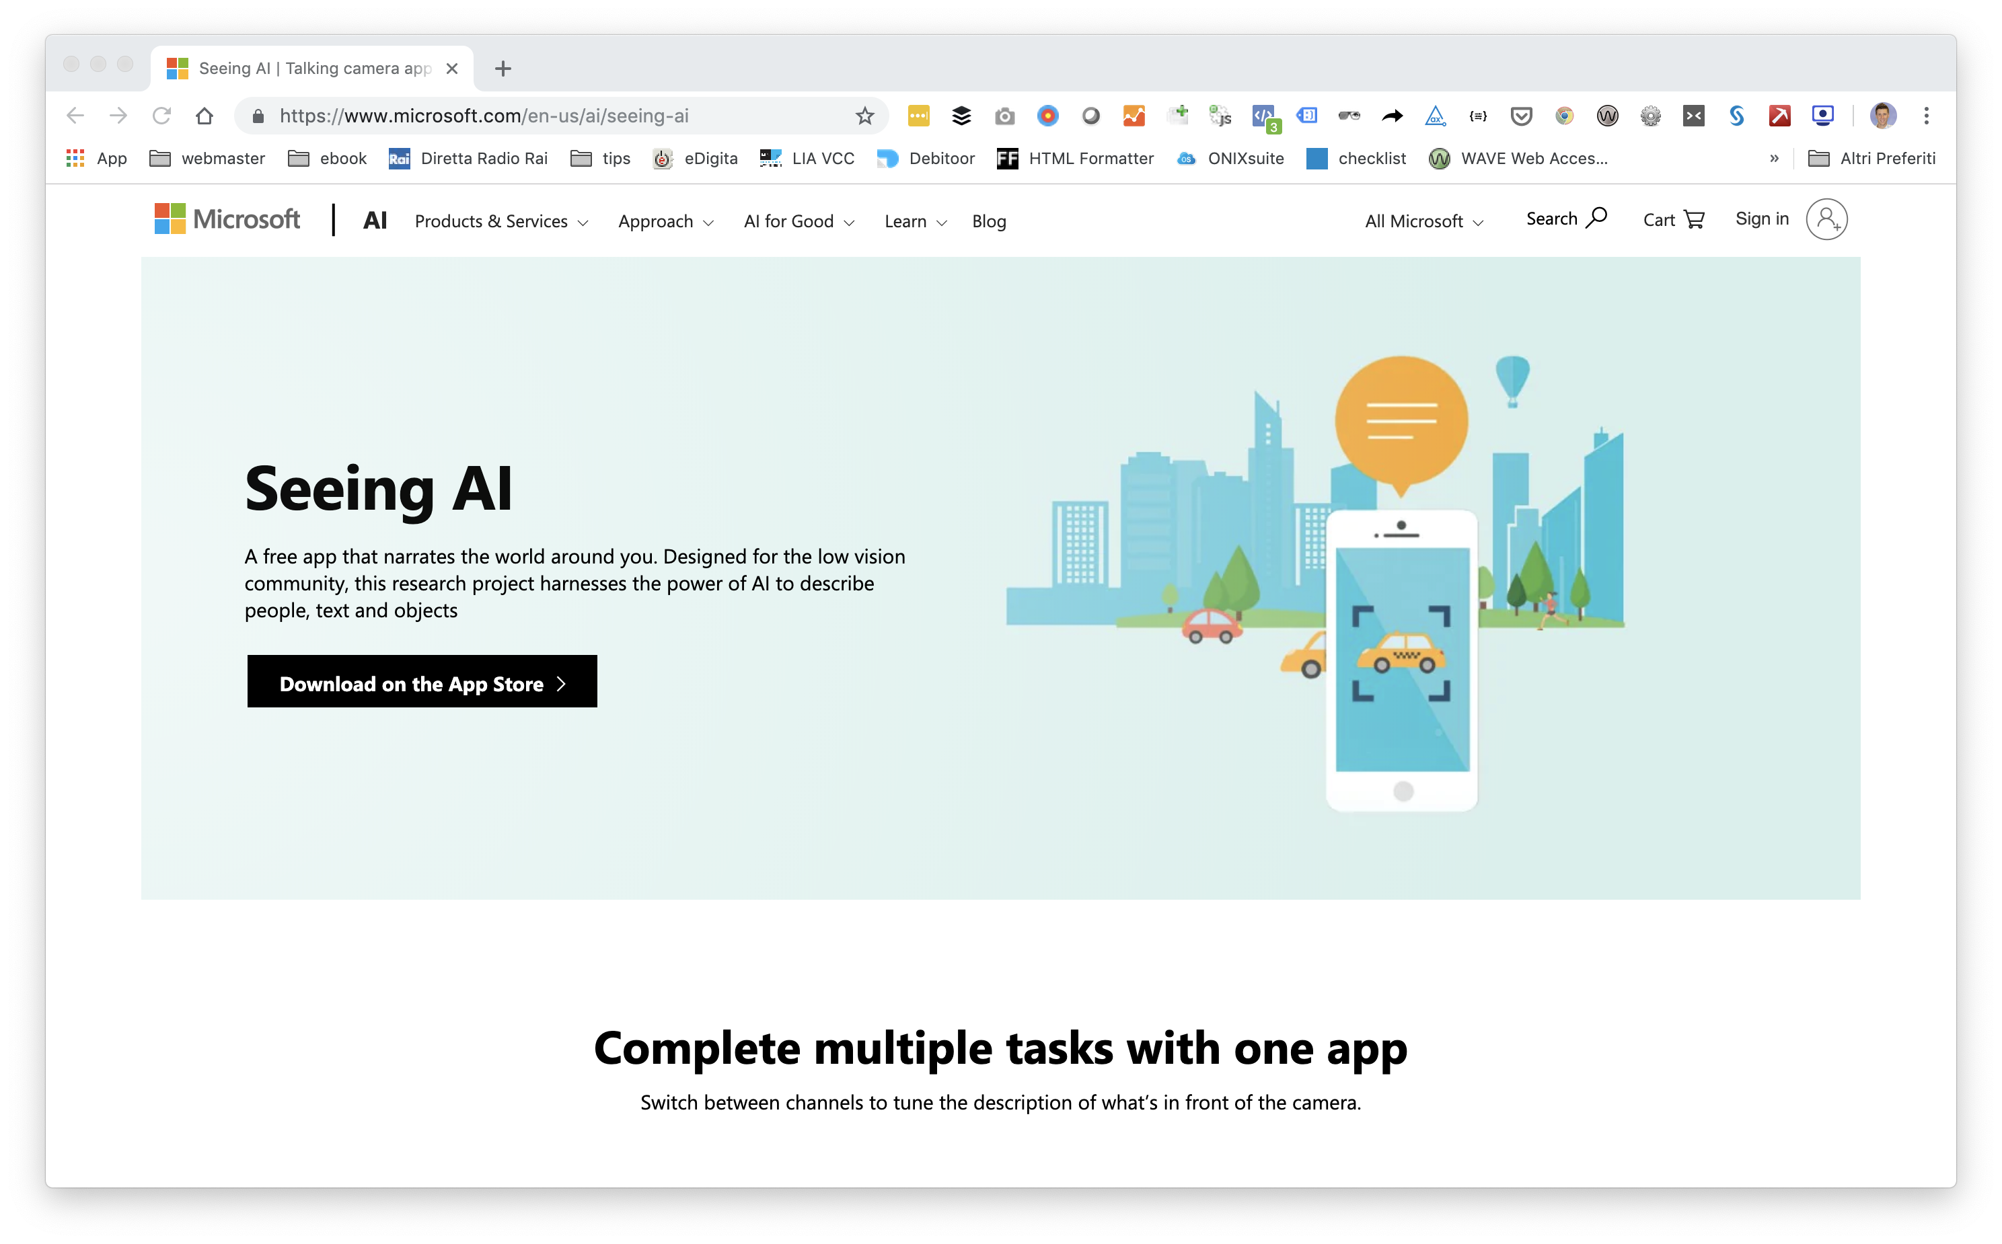
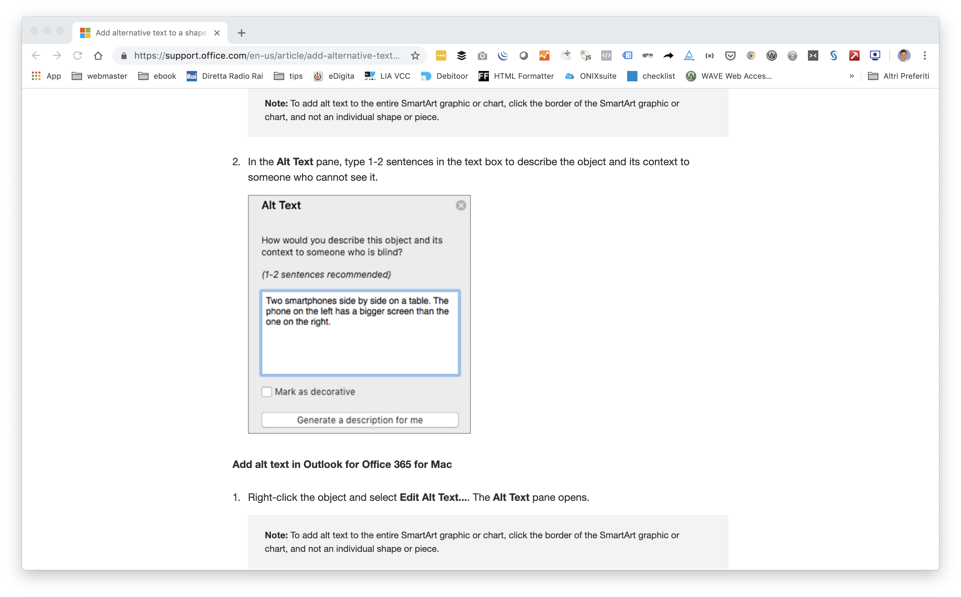
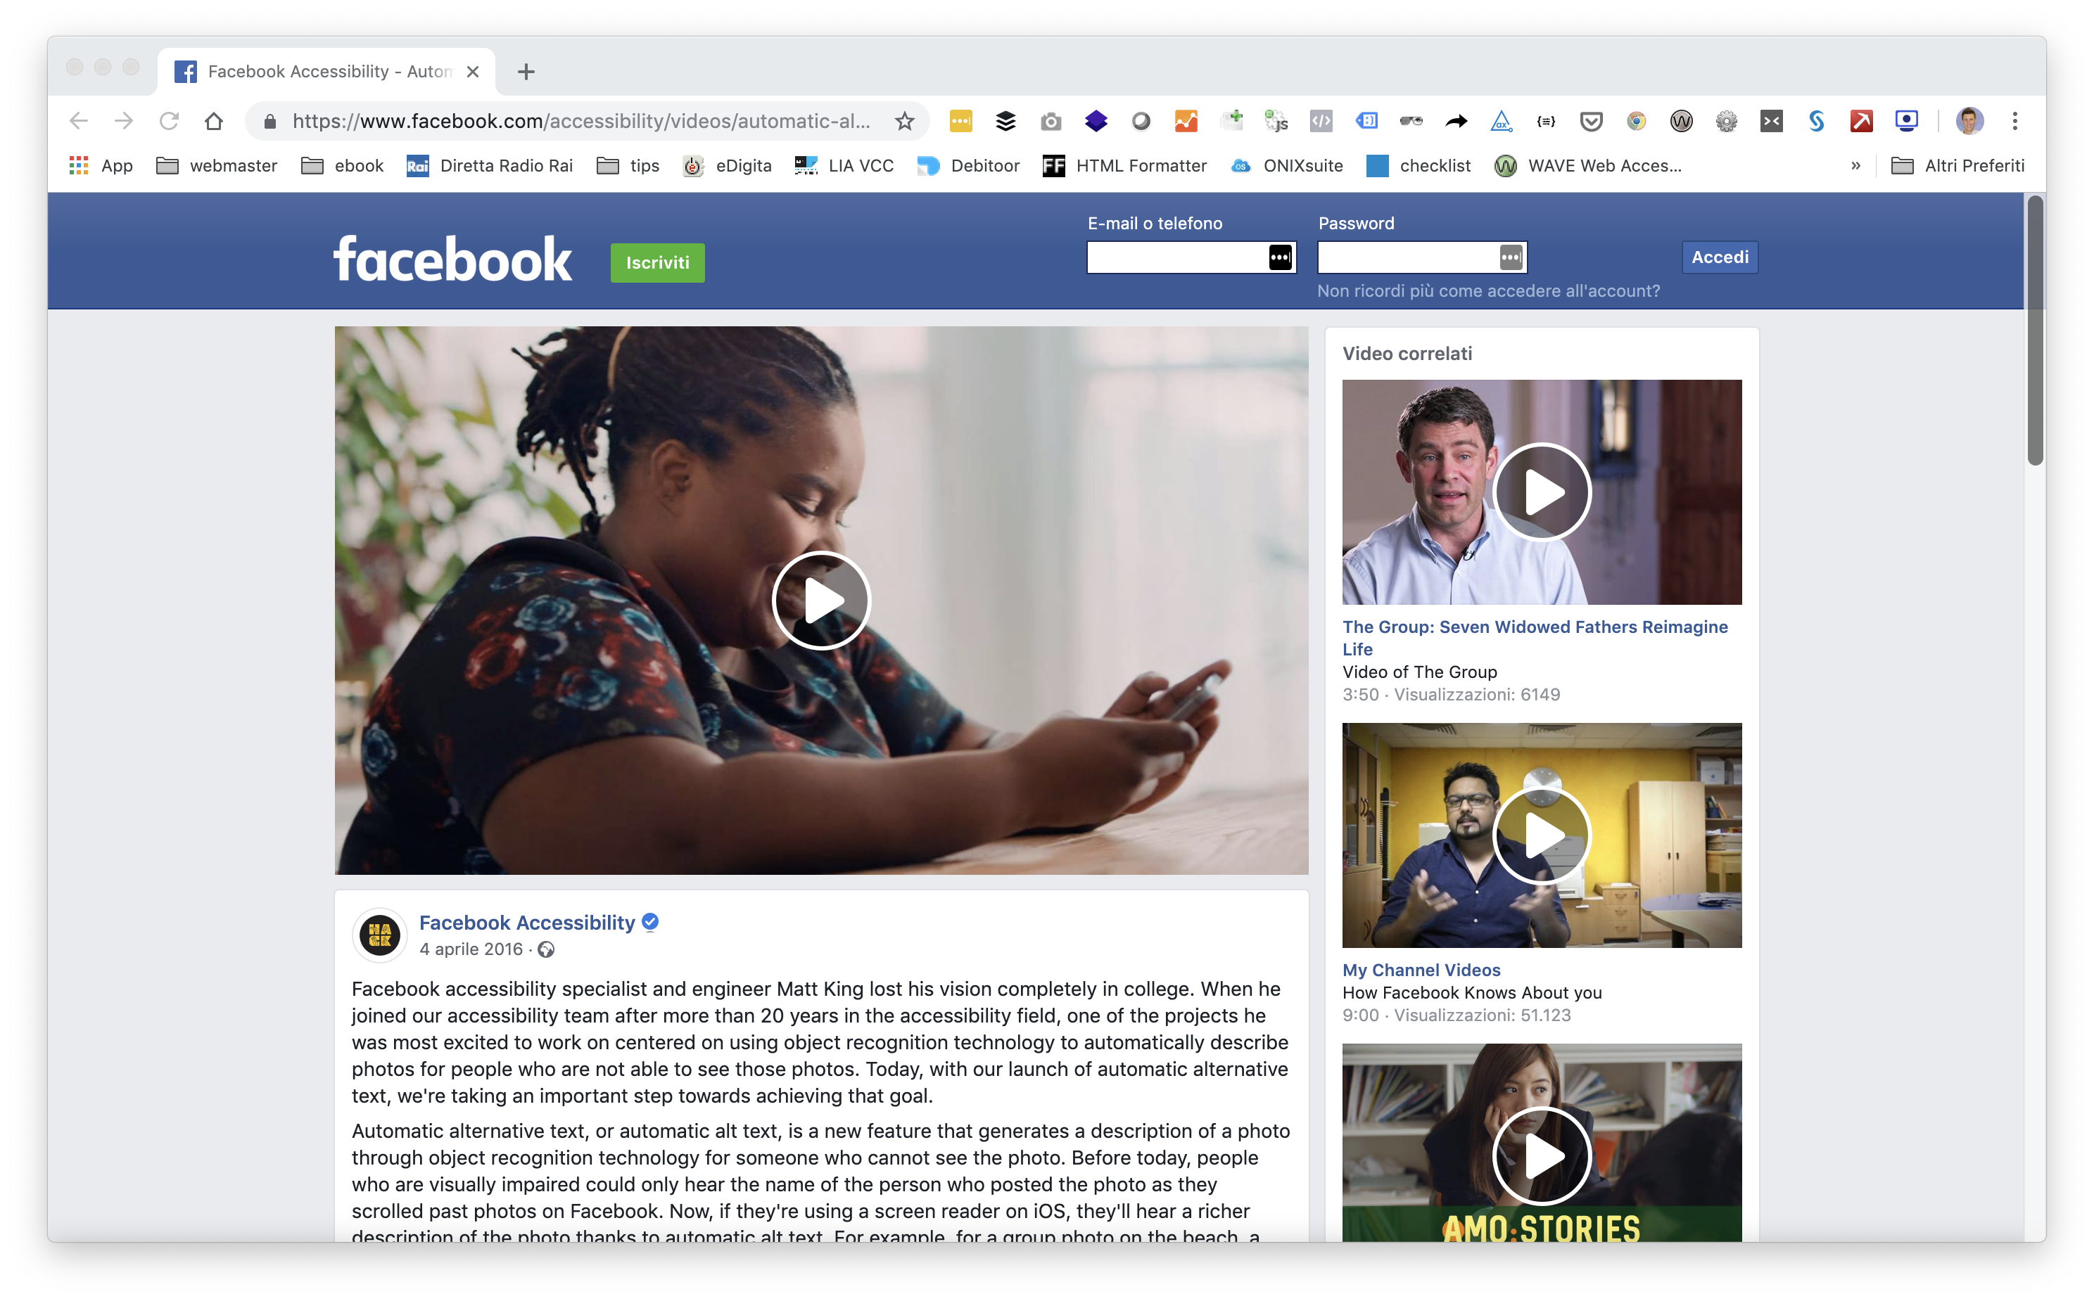
Industry trends

Slide 15
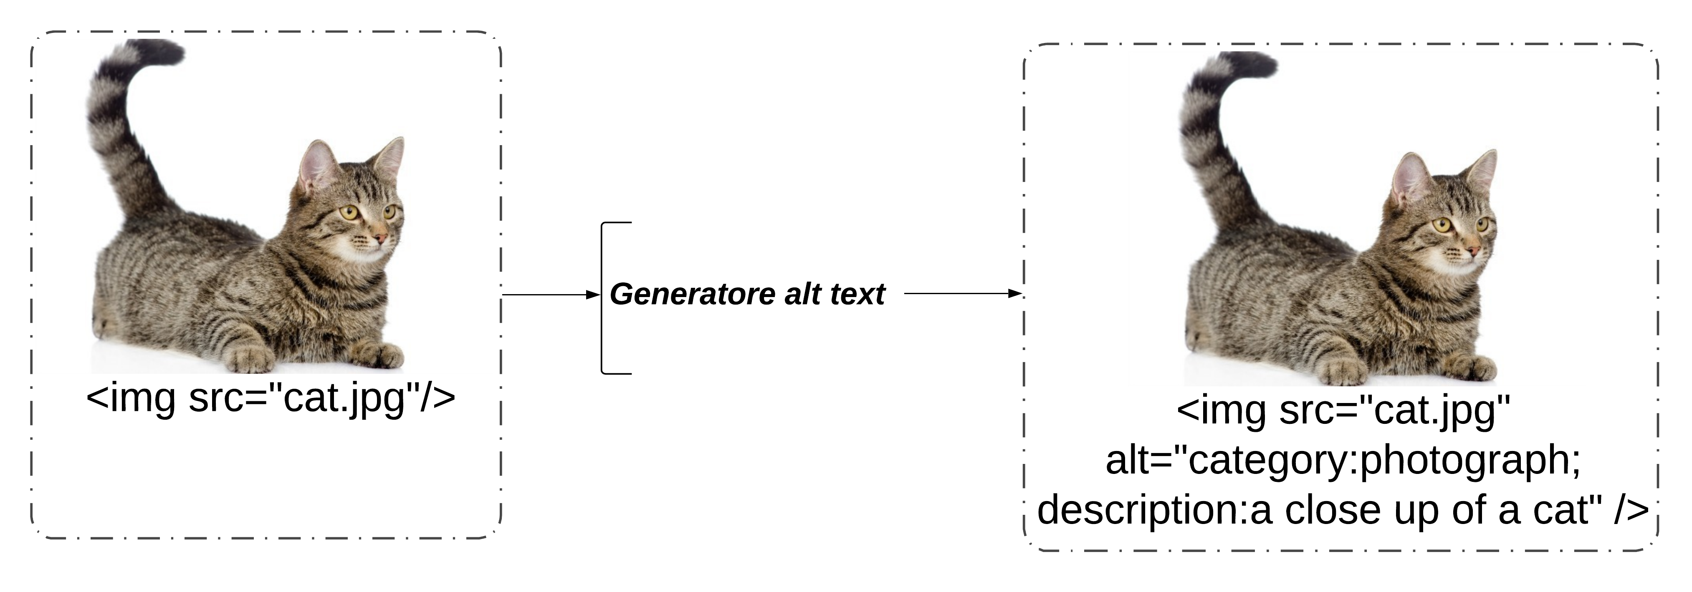
Automatic alt-text remediation for EPUB
Alt-text generator

Slide 16
Categories
CATEGORIES
Art
Comic
Complex
Cover
Text
Drawing
Flag
Icon
Logo
Map
Photograph
Signature

Slide 17
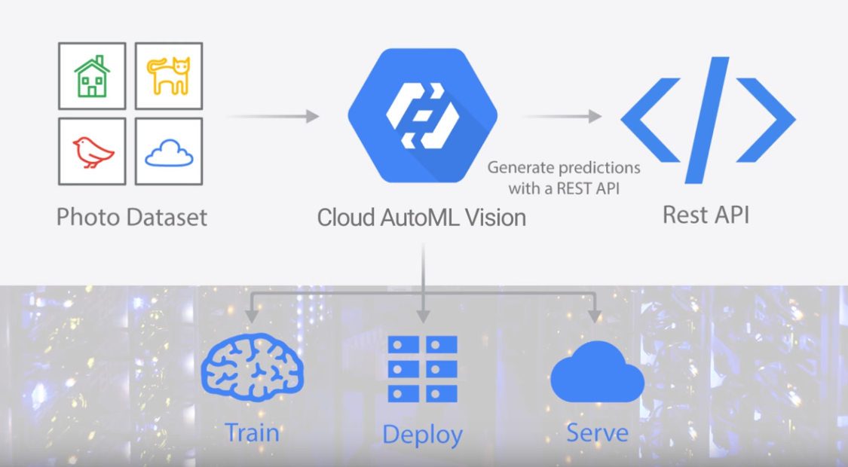
Classifier: Google Cloud AutoML Vision

Slide 18
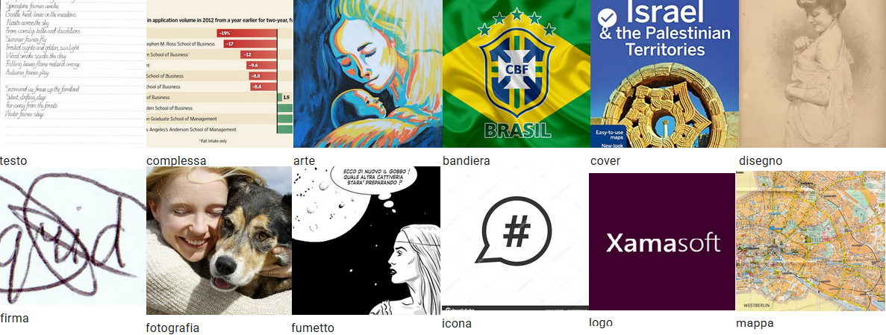
AutoML Dataset
1000 images per category, for a total of 12000 images;
80% of the dataset used for training: training set;
10% of the dataset used to optimize the model hyperparameters: validation set;
10% of the dataset used to evaluate the model: test set.

Slide 19
Training results

Slide 20
Alternative description according to LIA
image category
description of the image

Slide 21
Comparison of available services for image description
Service Name | Features
Microsoft Computer Vision | Categorization according to a specific taxonomy, dominant colors / white and black, labeling, description, presence of faces, type image ( clipart / drawing "dashed"), content for adults, celebrities, places, ocr and handwritten text recognition (beta)
Clarifier | Labeling of images from a recognition model trained to recognize a certain category of concepts. Some models (full list https://clarifai.com/models): general, face recognition, celebrities, violent or adult content, food,...). You can create your own template and train it with your own set of images and categories
Amazon Rekognition | Labeling of objects and scenes (sunset, beach,...), recognition, facial analysis and comparison, celebrities, adult content, ocr
Google Cloud Vision | Labeling, web detection (entity categorization by searching for similar images), ocr, handwritten text (beta), logos, content for audlti/violent/racist (safeSearch), dominant colors, product search (beta), facial detection (unsupported recognition) Ability to create and train custom templates
CloudSight | Image description, main subject recognition image
IBM Watson Visual Recognition | Label, facial recognition (no celebrity), food, explicit content

Slide 22
Selected services
Google Cloud Vision API
OCR, logo recognition, matching of web entities § for information retrieval
Microsoft Computer Vision
Description of the images

Slide 23
Service by classification
art, drawing, icon, photograph
Microsoft Computer Vision
generation of the description
flag
Google Cloud Vision API
cover, text
logo
comic, complex, map, signature
matching on entities through pattern or logo recognition
Google Cloud Vision API
OCR
Google Cloud Vision API
logo recognition
none
no description

Slide 24
Process
Google Cloud Vision API
images
category
description
Google Cloud AutoML Vision
Microsoft Computer Vision

Slide 25
Some tests

Slide 26
CATEGORY
cover
DESCRIPTION
LLi.ERLiNo.fua tal Mu.ve e inpiere.avi.spettacel.NOV: 9- 89.RDOR.EFFATA, D EDITRICE.

Slide 27
CATEGORY
logo
DESCRIPTION
red twitter

Slide 28
CATEGORY
text
DESCRIPTION
EFFATA'.EDITRICE.

Slide 29
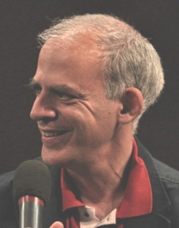
CATEGORY
photograph
DESCRIPTION
a man looking at the camera

Slide 30
CATEGORY
cover
DESCRIPTION
FEDERICA PEGORIN, STECCHERINO.FRANCESCO.GUCCINI.L'ULTIMA VOLTA.

Slide 31
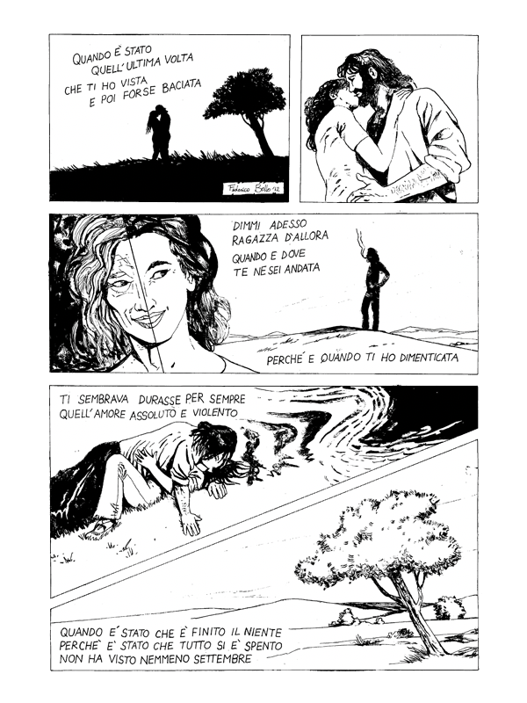
CATEGORY
comic
DESCRIPTION
-

Slide 32
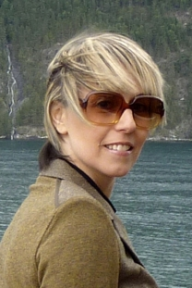
CATEGORY
photograph
DESCRIPTION
a person wearing glasses and smiling at the camera

Slide 33
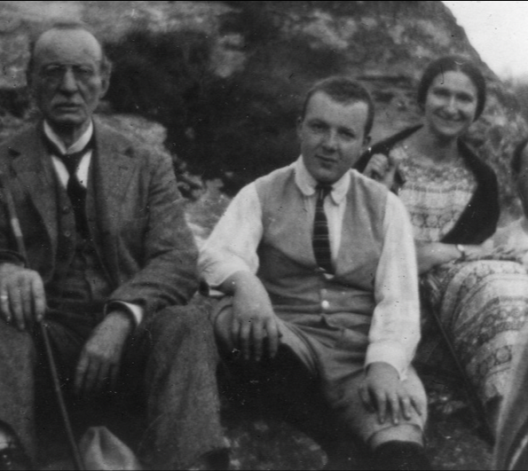
CATEGORY
drawing
DESCRIPTION
a vintage photo of John Ericsson et al. posing for the camera

Slide 34
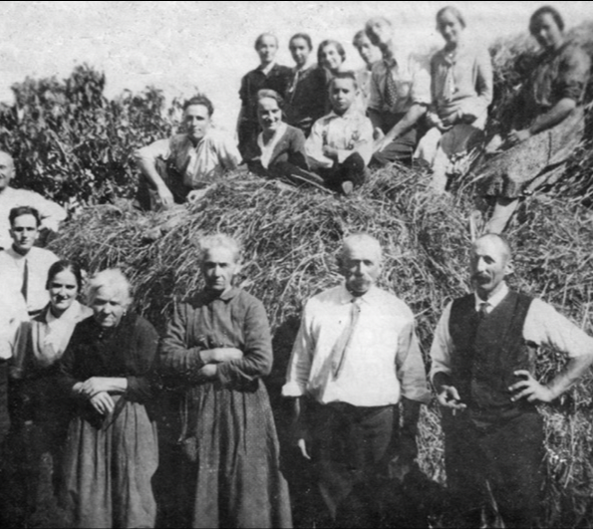
CATEGORY
drawing
DESCRIPTION
a vintage photo of a group of people posing for the camera

Slide 35
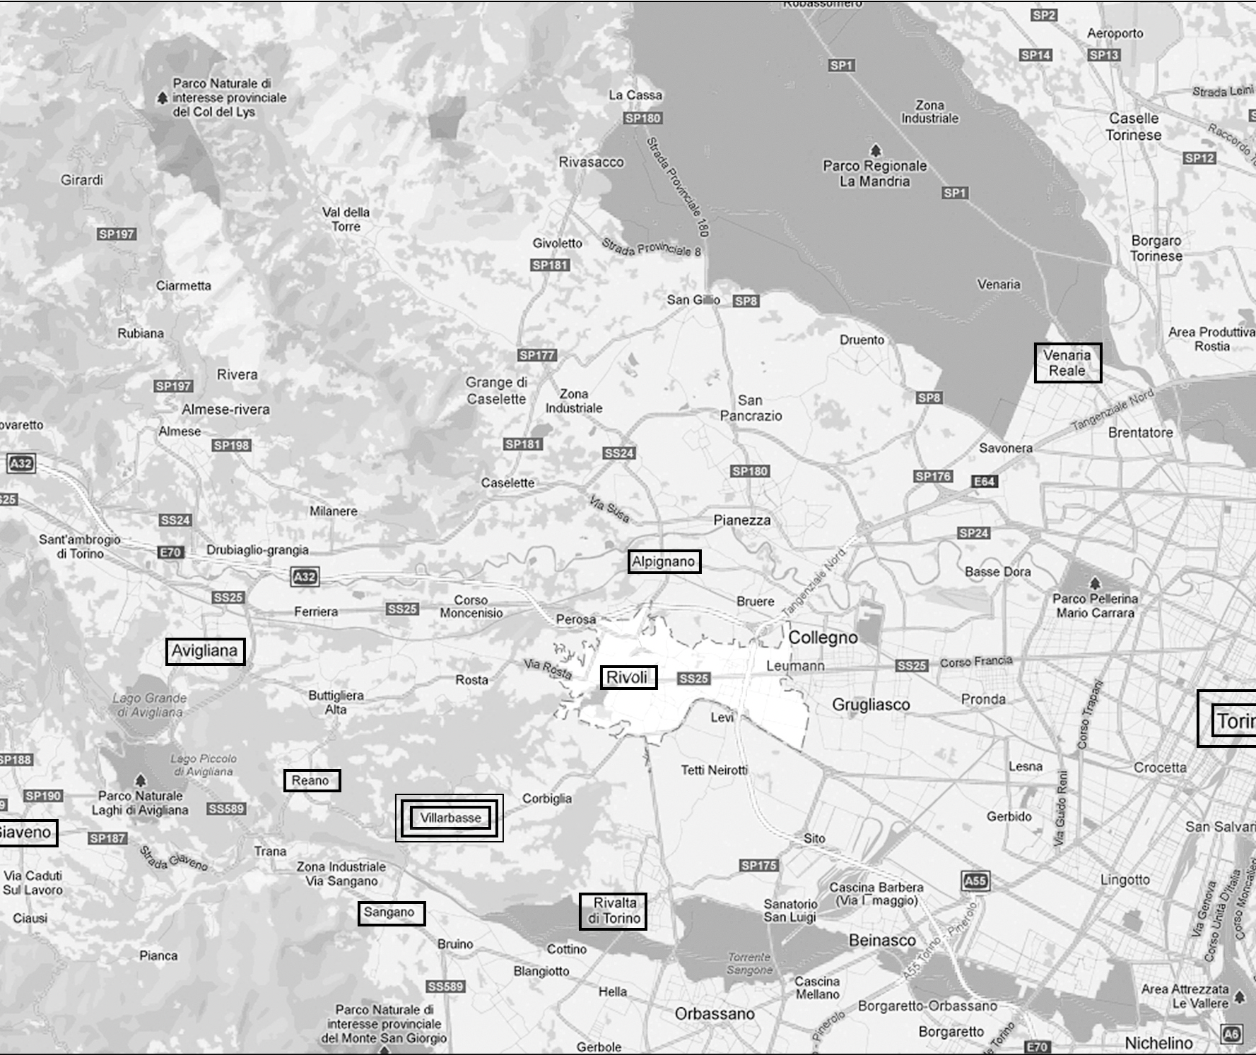
CATEGORY
map
DESCRIPTION
-

Slide 36
CATEGORY
text
DESCRIPTION
Marinella Grosa.La casa ritrovata.Storia (e storie) dell.a.scina Simonetto di Villarbasse.EFFATA,.EDITRICE.

Slide 37
Overall accuracy

Slide 38
Questions, questions

Slide 39
Thanks

