Slide 1
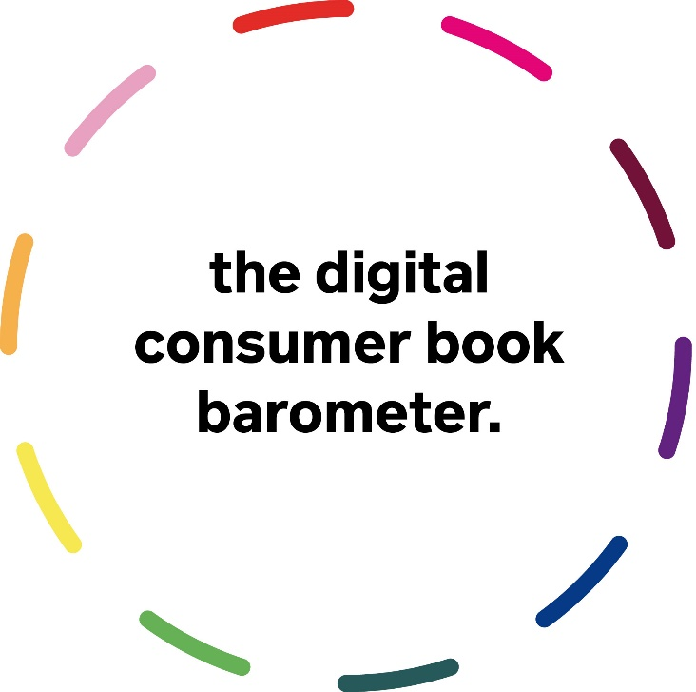




E-books and audiobooks 2019
In Canada, Germany, Italy, The Netherlands, Spain & English Imports
Sponsored by

Slide 2

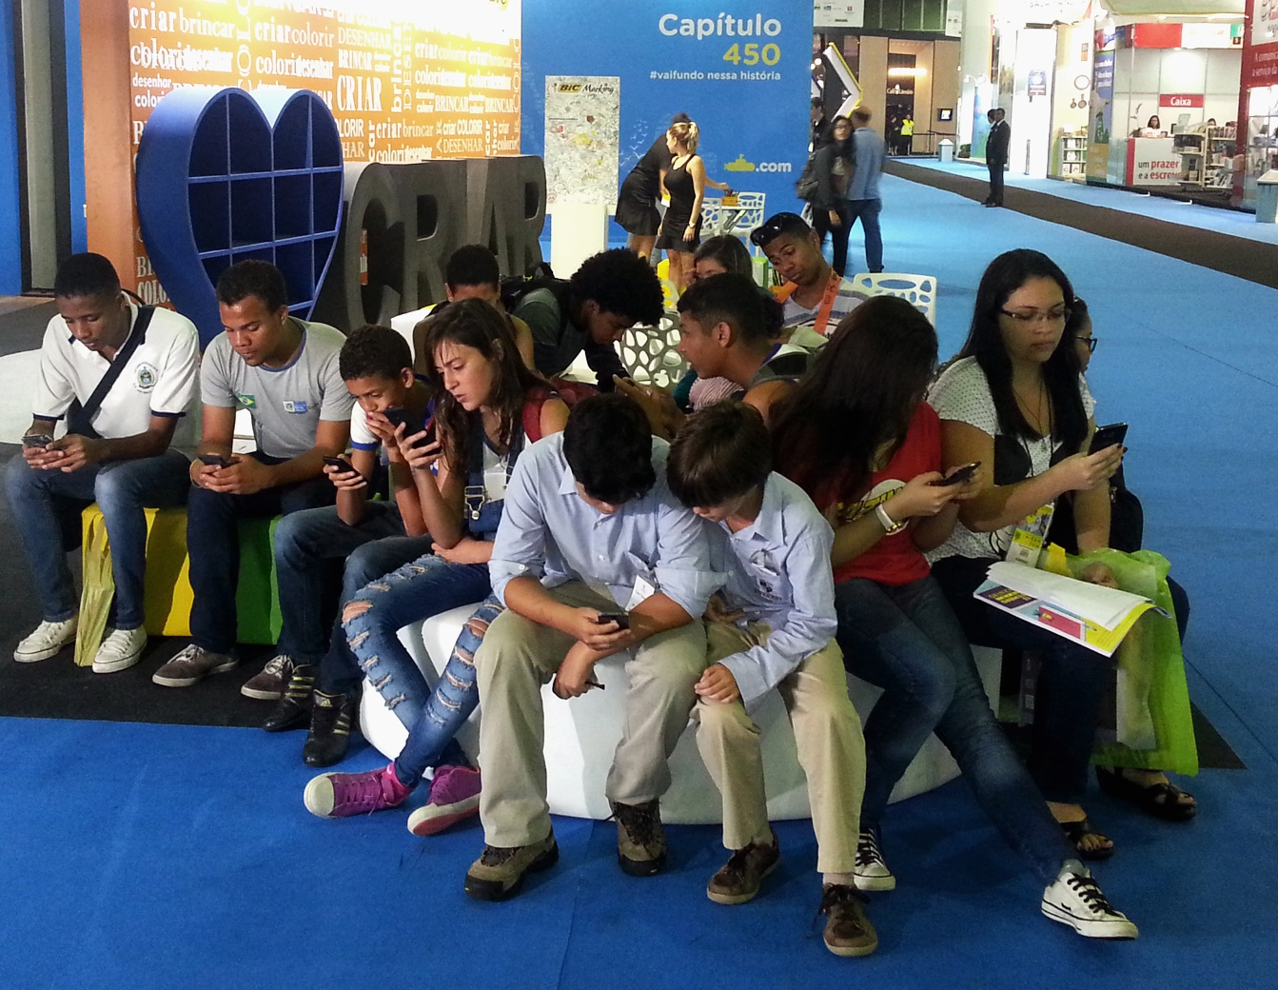

Reading changes
> and so does the audiece

Slide 3

More than 1 way to be a reader
Together & in communication
Alone & immersed

Slide 4
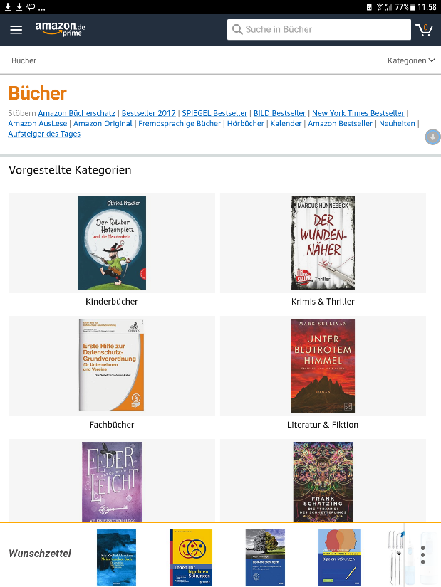
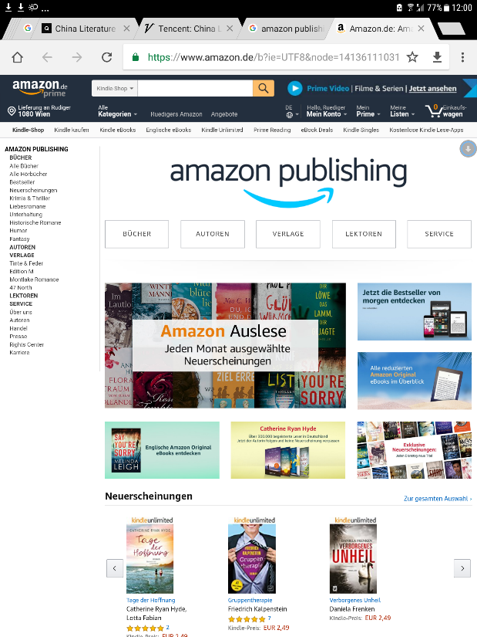
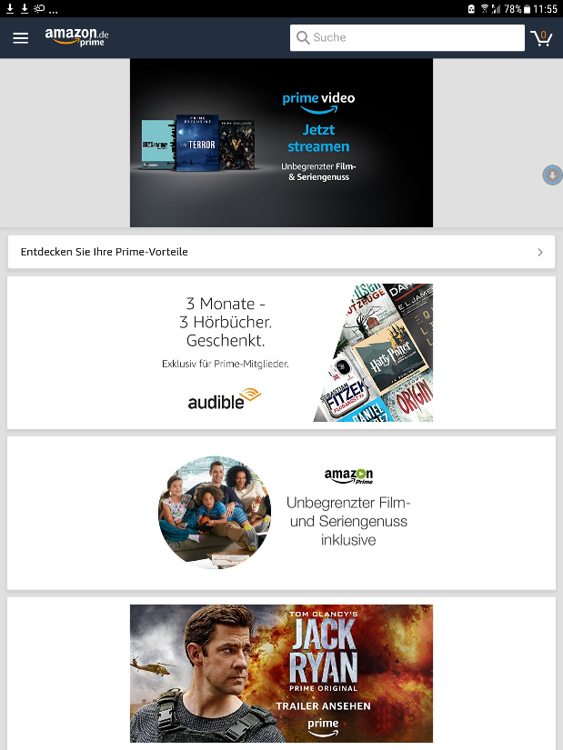
The eco-system of Amazon

Slide 5
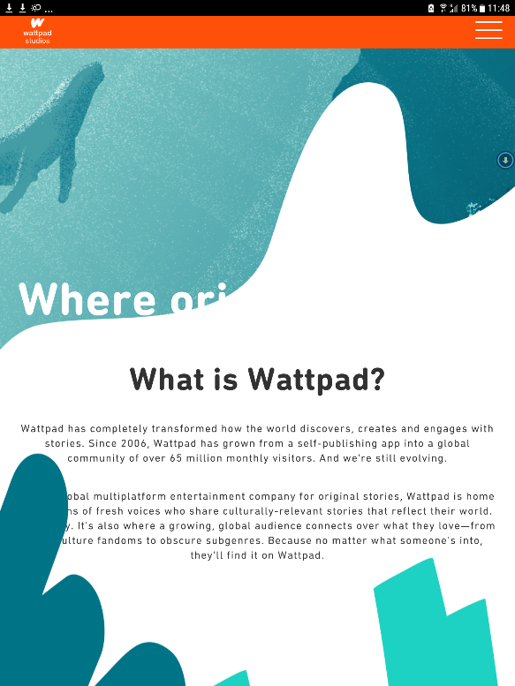
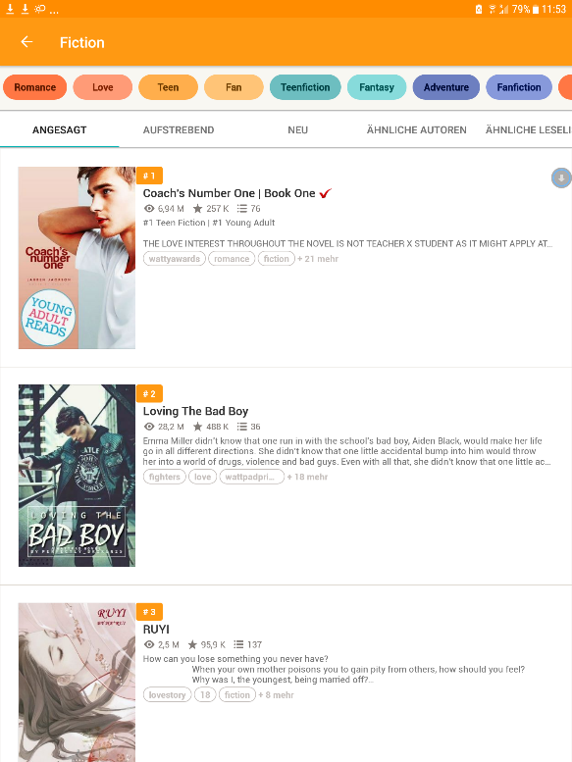
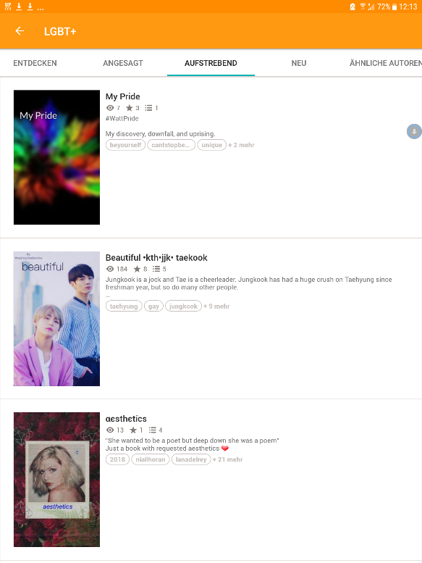
The new universes of ‚platforms‘ e.g. WattPad (Studios)
60 m monthly users
Authors > writers >
Any media
Driven by audiences
(e.g. LGBT+)

Slide 6

The new universes of ‚platforms‘ e.g. WattPad (Studios)
"...global multiplatform entertainment company
for original stories..."
Authors > writers >
Any media

Slide 7

JK Rowling as a strategic principle
Pottermore >>
The industrialization of a character brand across all media and formats, like Walt Disney in the 1920s & 1930s.
Standardized globalization
Innovative use of new technologies
Commodization of an author & story telling brand)

Slide 8
Amazon Top 25
Selected genres & formats aggregated (June 13, 2019)

Slide 9
Mobile-First Online Activities
18%
72%
100%
Courtesy Global WebIndex, 2018

Slide 10
From e-books to digital consumer books
“Books are increasingly considered exquisite, destined for a small elite. Literature could disappear from the public sphere.”
Morten Hesseldahl, Gyldendal Publishers, Denmark, September 2018
Ebooks – Phase 01: Why digital containers with copies of printed books are only one way for a reader to approach ‘long-text’ on a digital device.
Ebooks - Phase 02: Platforms and ecosystems, new business and distribution models, and a coexistence of many digital formats.

Slide 11
Evidence
‚Format‘ has lost its central significant. With the sudden rise of audiobooks, even ‚type‘ and ‚reading‘ have been subsituted by ‚voice‘ and ‚listening.
Self-publishing by now forms a new segment in the story telling industries.
KDP, Wattpad, Netflix‘ buying spree for authors and stories or the new partnerships between Big Five corporate publishers and new platforms.

Slide 12
We learn
Books have ceased to have one clear format that everyone, for any given type of content and purpose, uses in similar ways.
Digital books are increasingly morphing into a continuous stream, or flow, of media which newly forming audiences consume in various fluid ways.
Instead of e-books, we must analyse and understand ‚digital consumer books‘ now.

Slide 13

But how can we measure ‚digital‘?

Slide 14

A report on e-book and audiobook sales in Canada, Germany, Italy, the Netherlands & Spain and digital imports
Aggregated sales data provided by
Bookwire
CB
DeMarque
edigita
Ingram
Libranda
Readbox

Slide 15
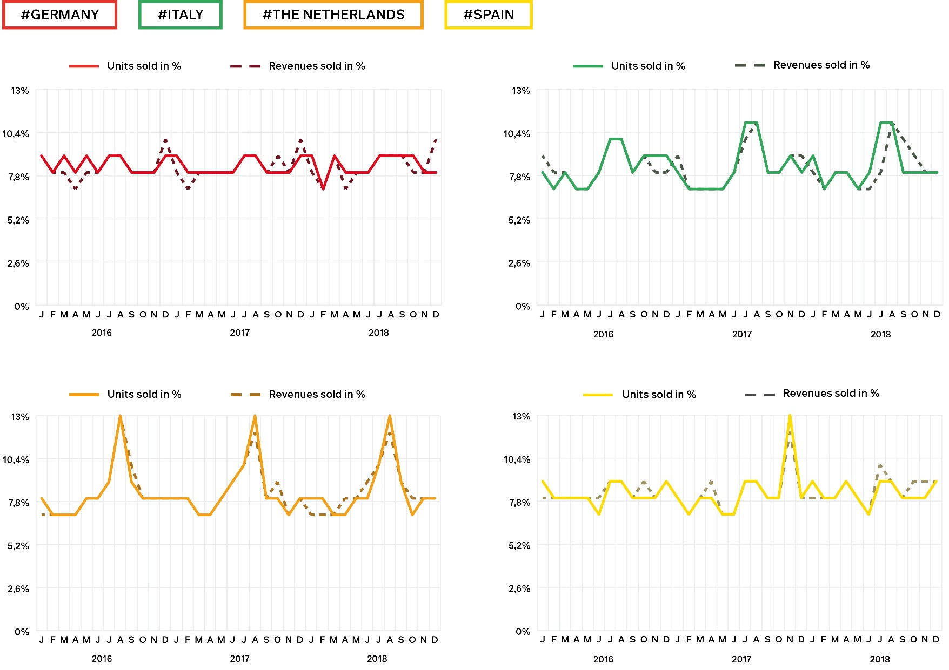
The annual calendar of e-book sales (Germany, Italy, The Netherlands, Spain)

Slide 16
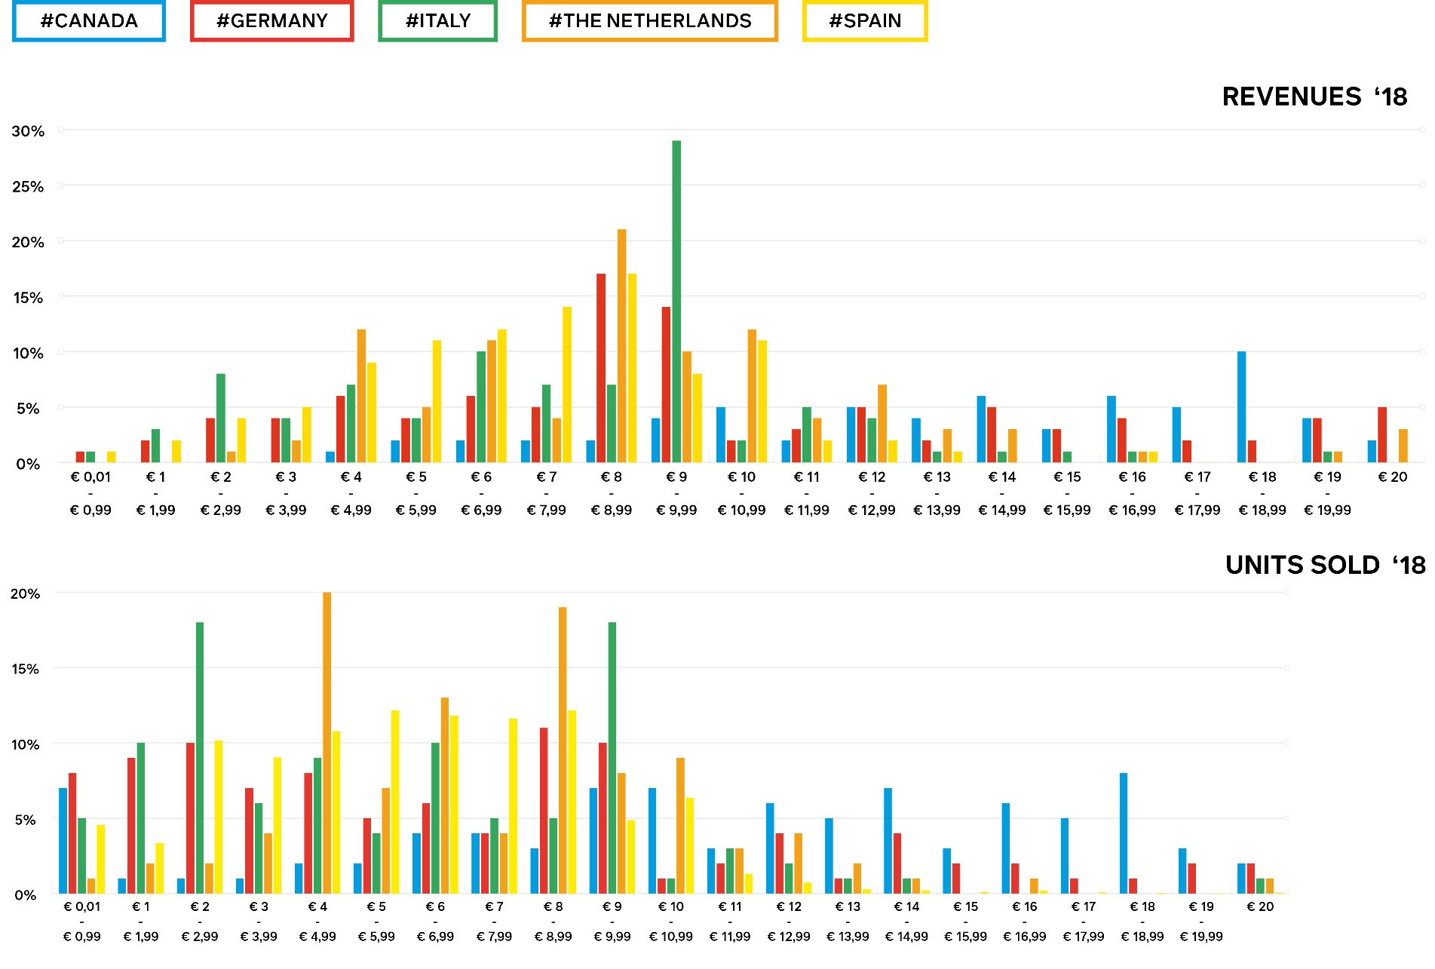
Comparing sweet spots in pricing across countries

Slide 17
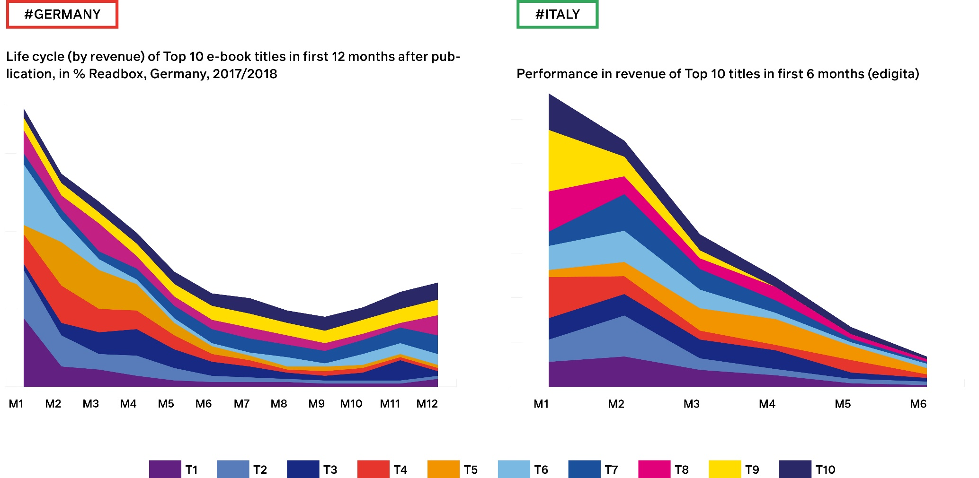
Life cycle of top 25 e-books: Quick sellers versus long sellers (Germany, Italy)

Slide 18
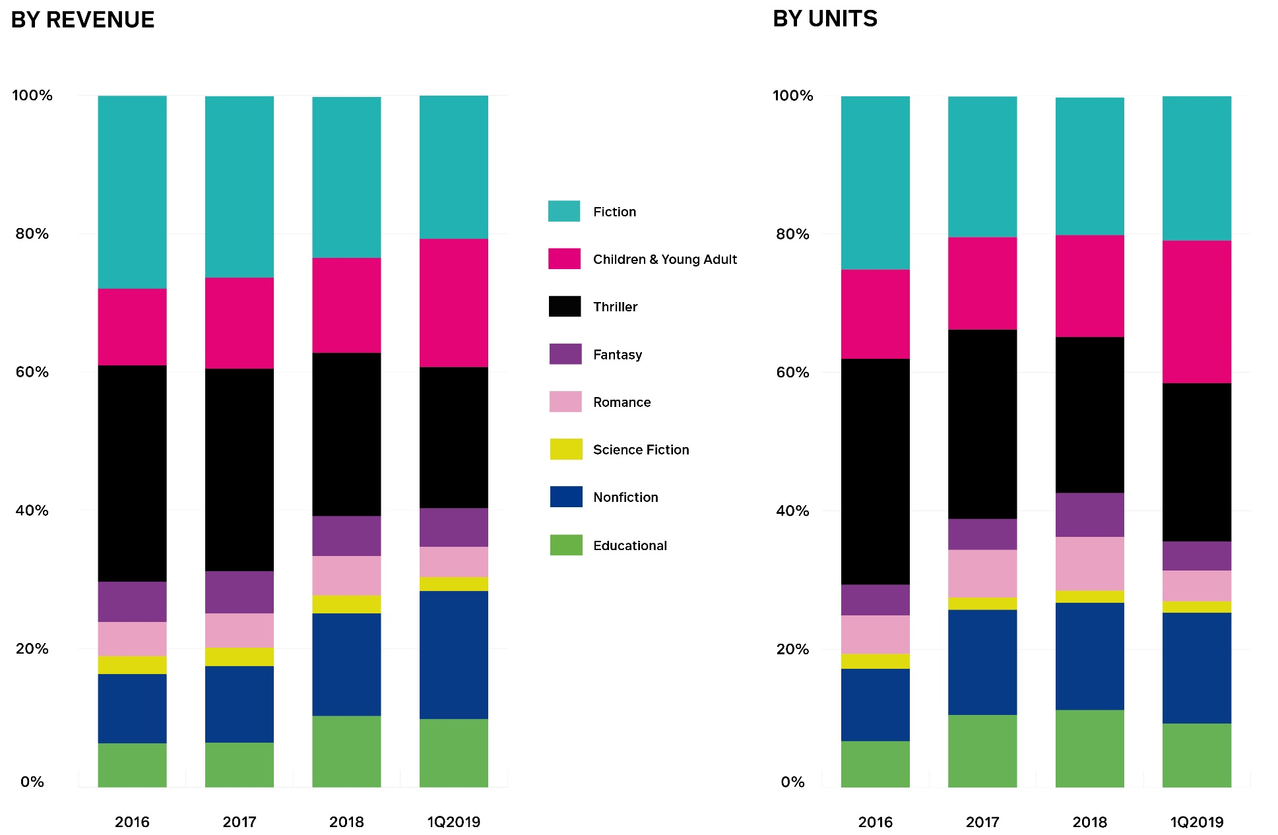
Evolution of genre categories in audiobooks (2016 – 1Q2019, Germany, Bookwire)

Slide 19
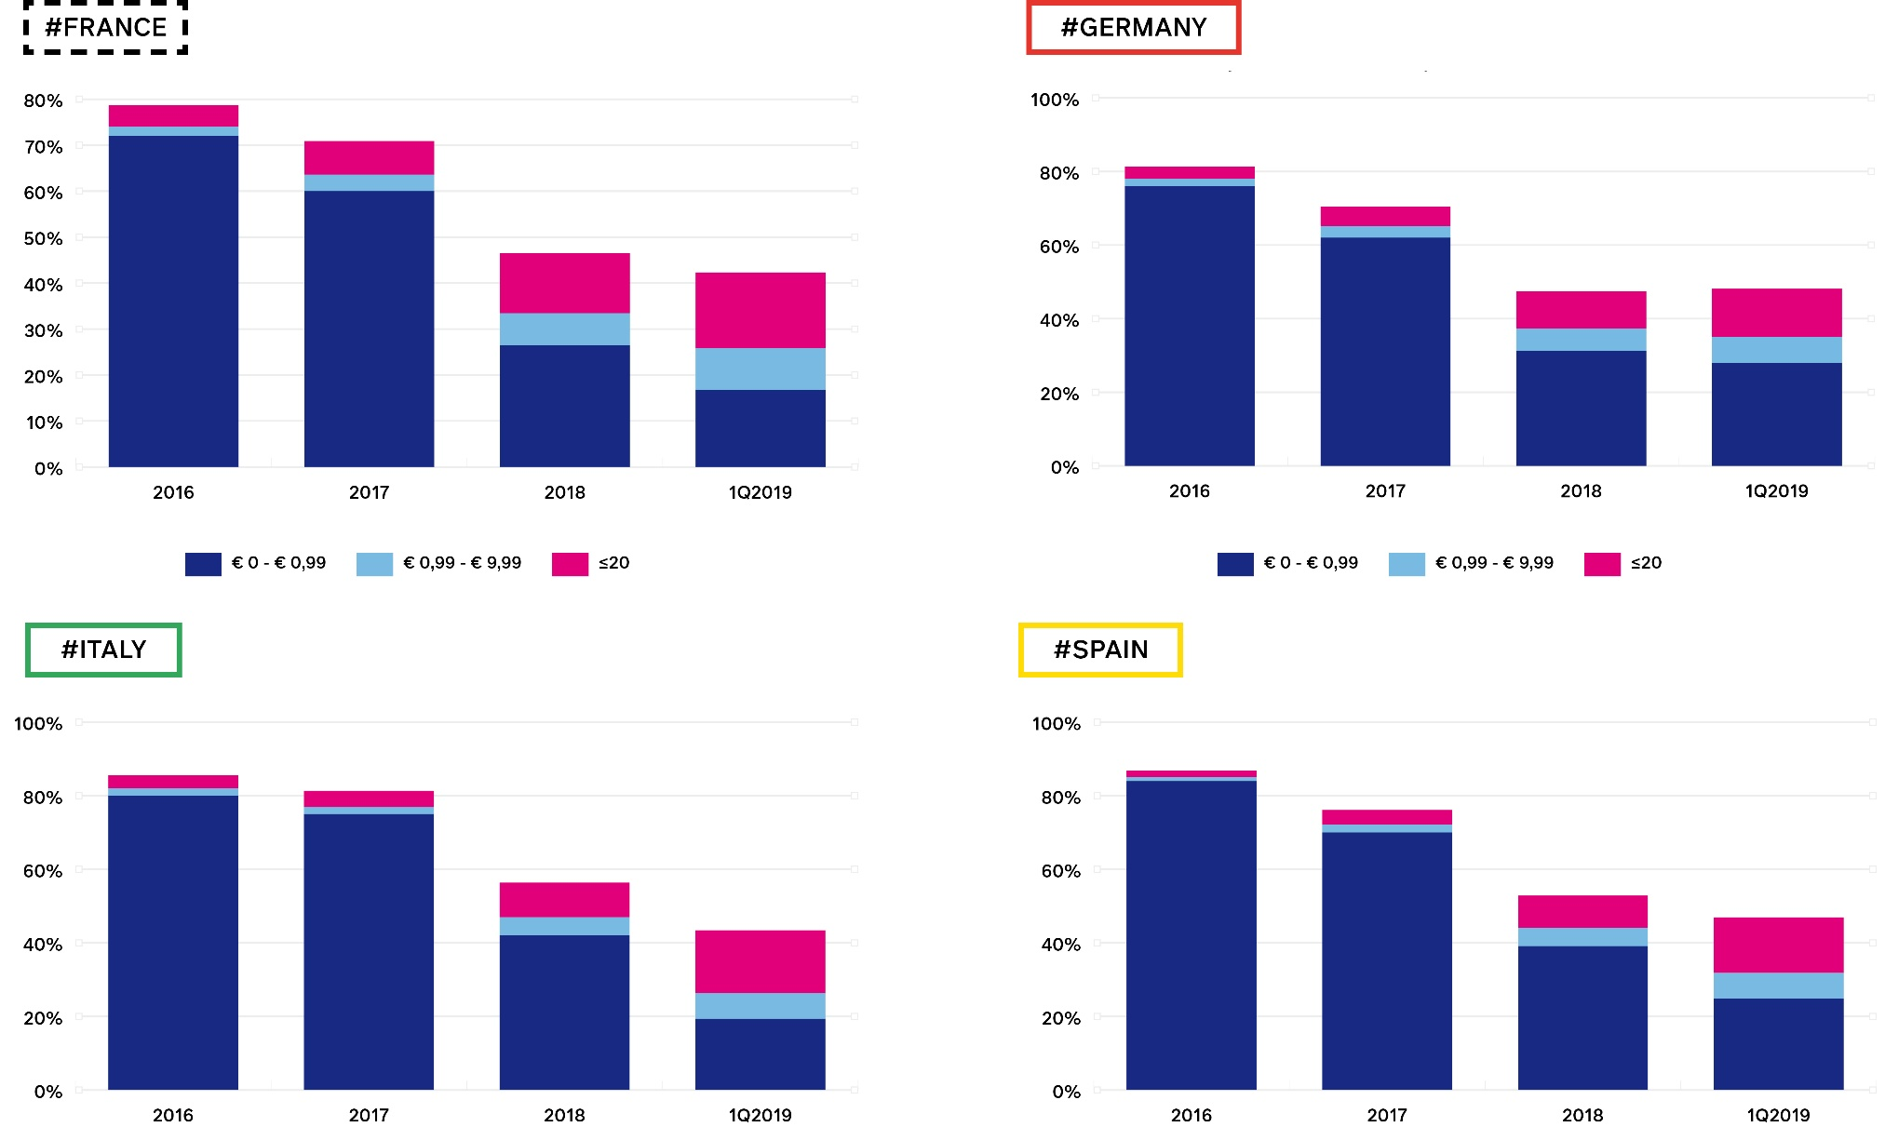
Foreign language imports

Slide 20
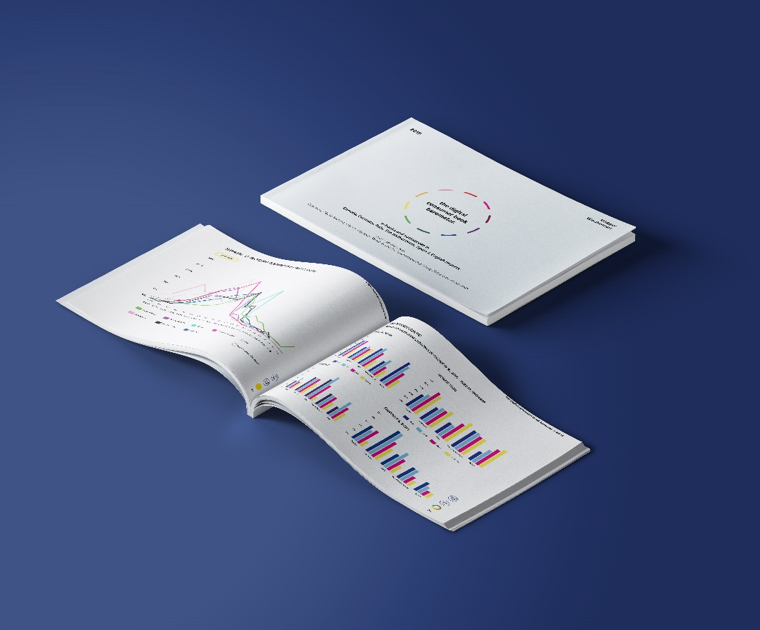
www.global-ebook.com
Sponsored by
Data also provided by CB, edigita, Ingram, Readbox

