Slide 1

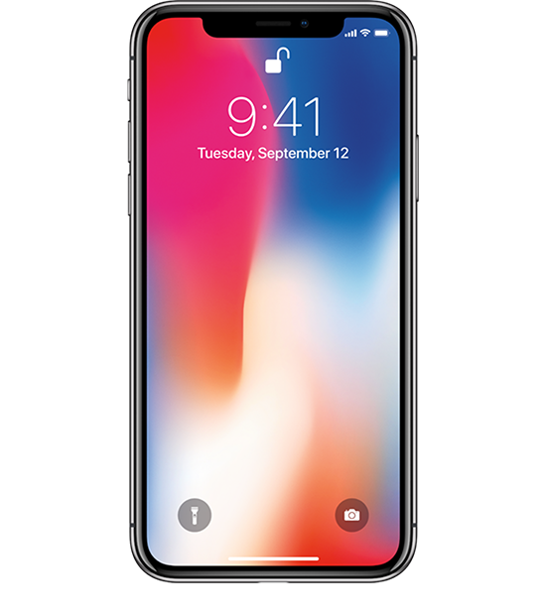

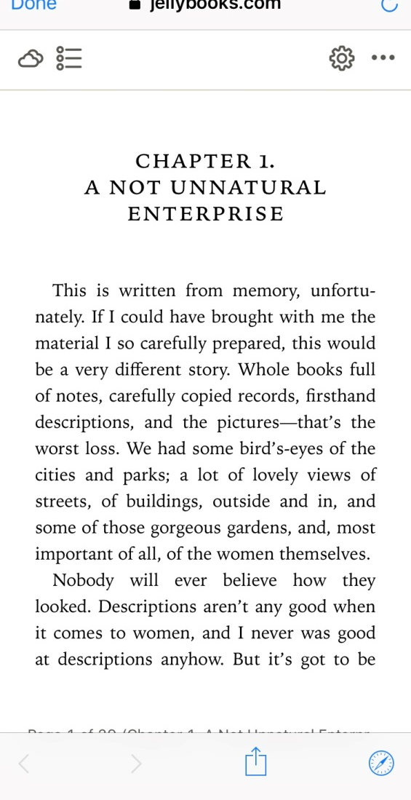

Readium for the Cloud data-smart book marketing
@jellybooks
@arhomberg

Slide 2

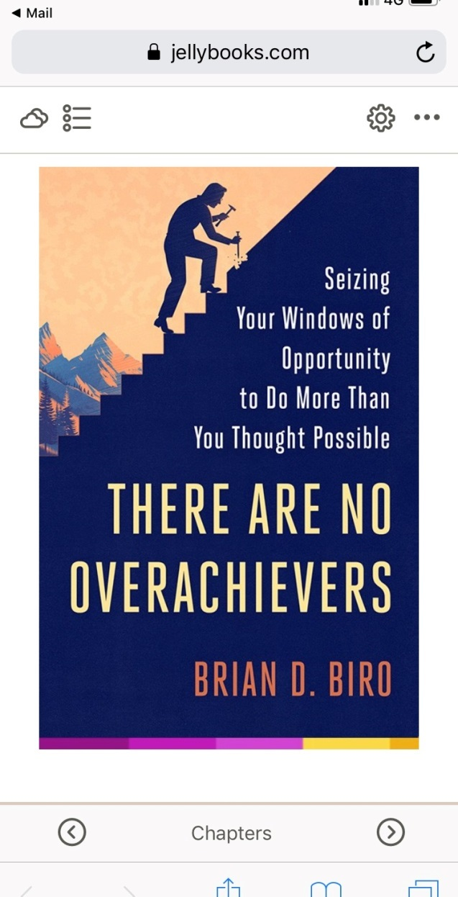
One-click access to ebook(s)
No files to download
No App to install
“Sharing and viewing as simple as on YouTube”

Slide 3

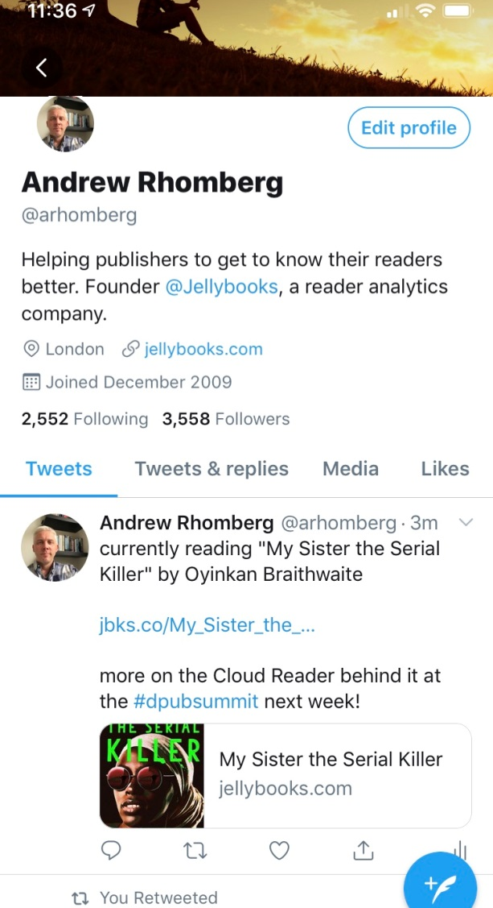
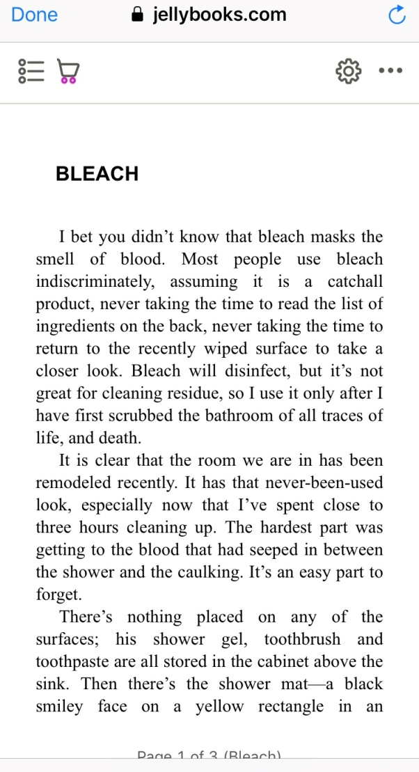
Jellybooks Cloud Reader
one click
(0.6 seconds)
jbks.co/My-Sister-the-Serialkiller

Slide 4

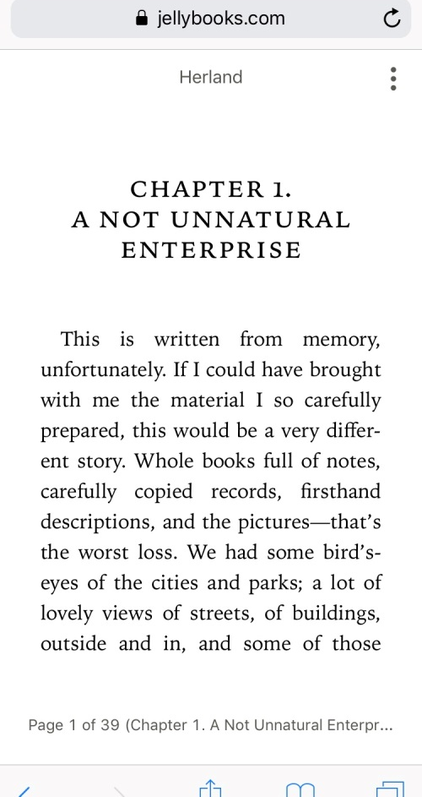
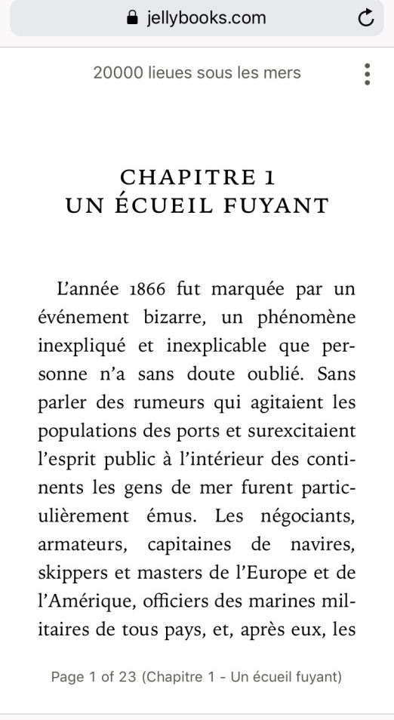
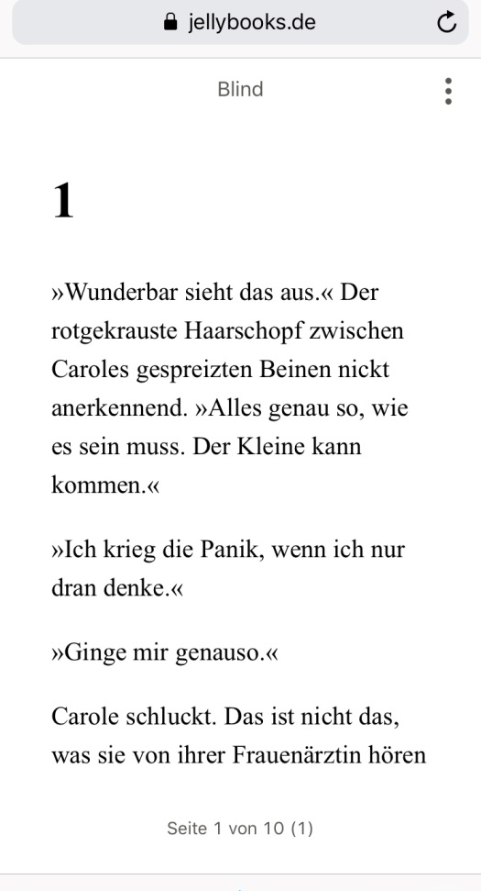
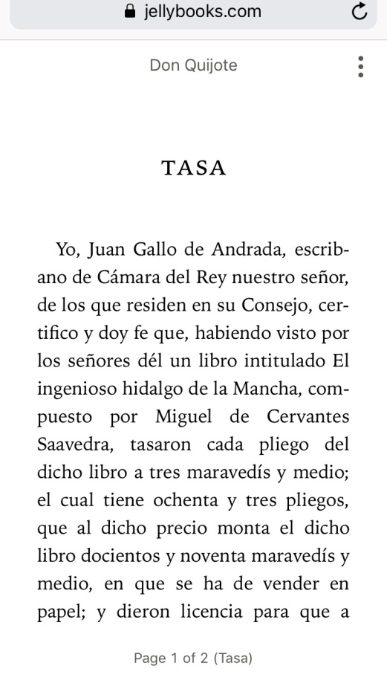
Try it out!
English
jbks.co/herland
French
jbks.co/Verne
German
jbks.co/Blind
Spanish
jbks.co/Cervantes

Slide 5

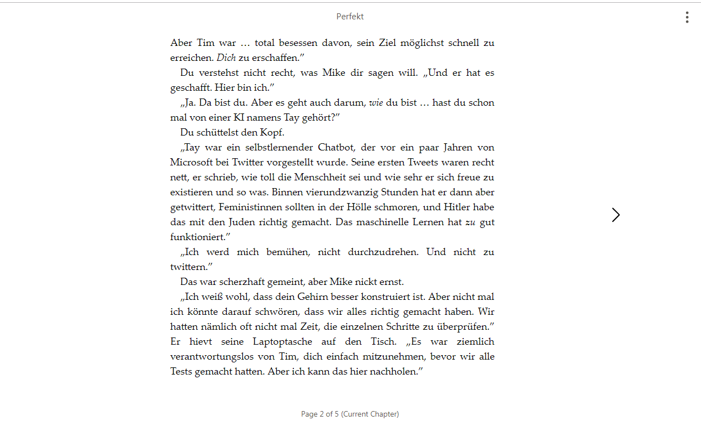
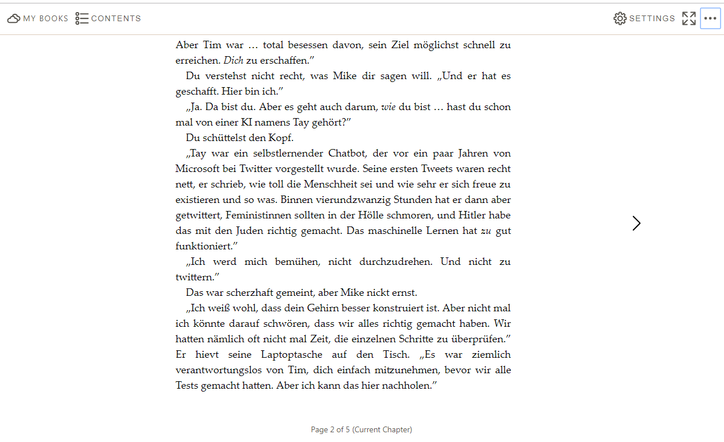
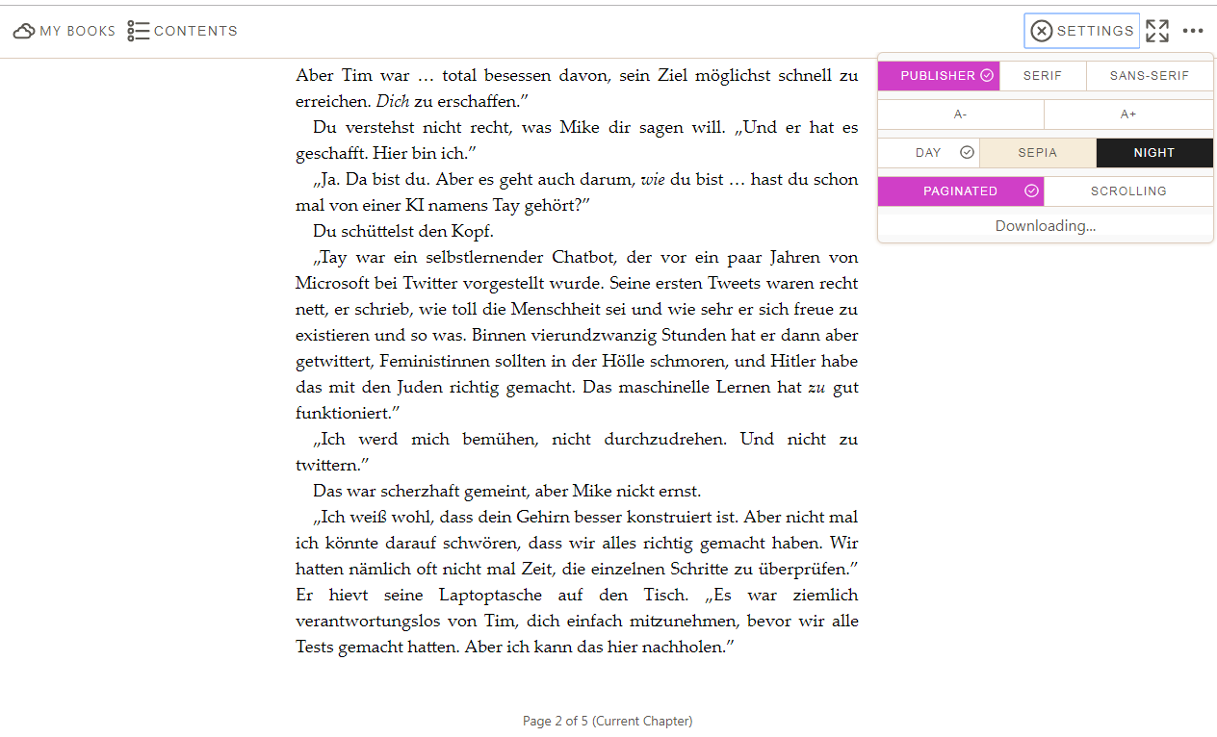
Simple User Interface (desktop)
Principle 1: The reader should never be left guessing how to perform an action.
Principle 2: Do not overload the reader with too many options.
Principle 3: Use familiar icons and symbols whenever possible.

Slide 6

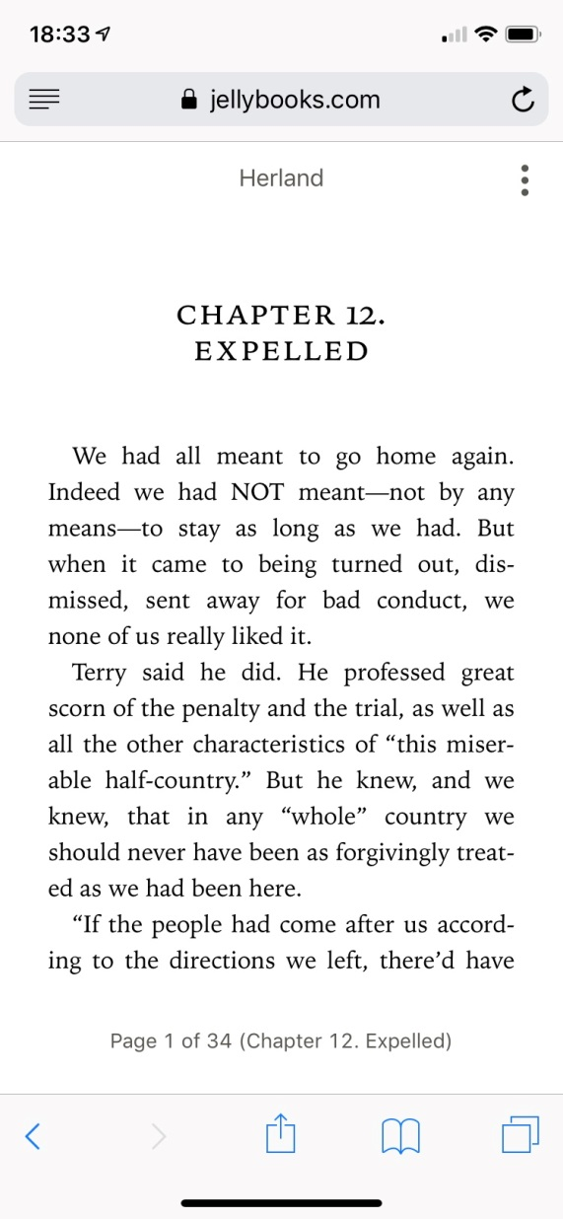
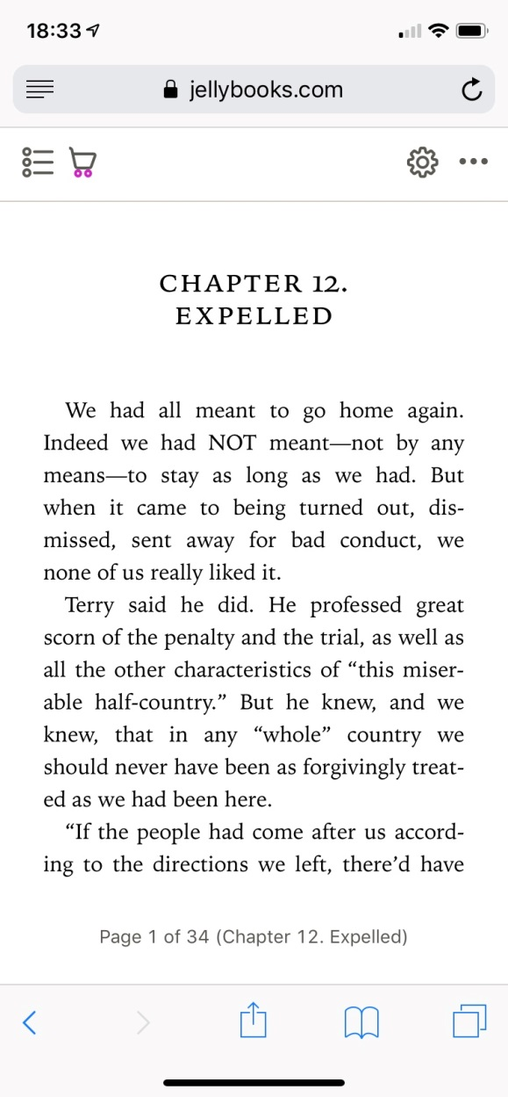
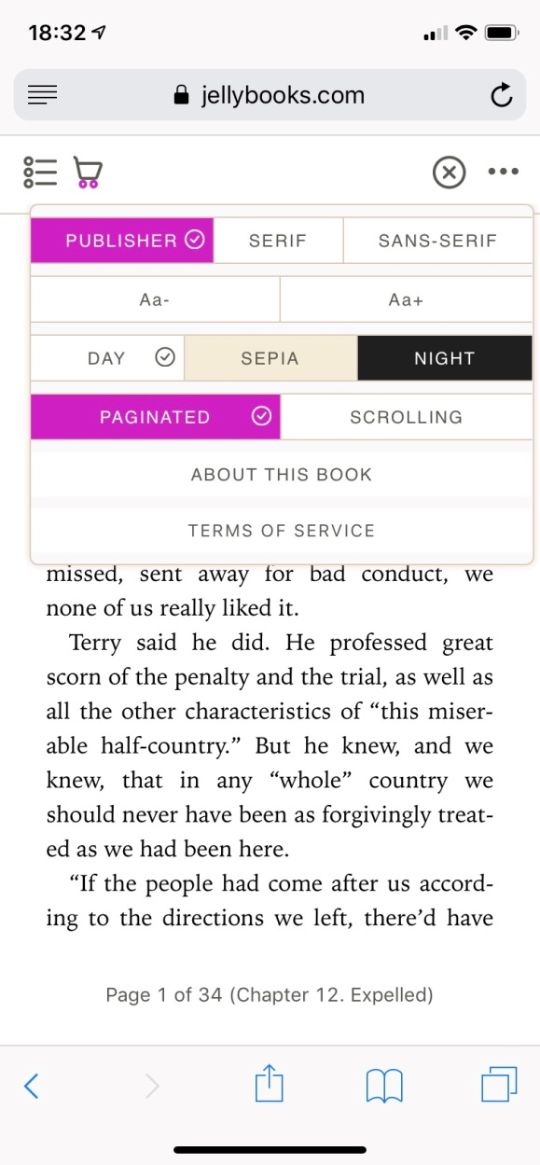
Simple User Interface (mobile)
6

Slide 7

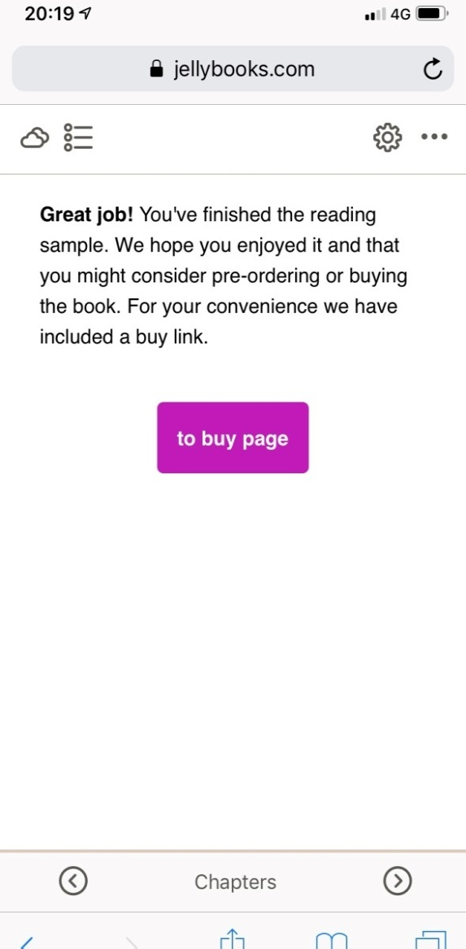
Click-to-Buy
It’s all about getting readers interested in buying a book
Promotes both digital and printed editions (print readers also use ebook samples!)
affiliate codes used to track conversion to actual purchase
Some “leakage” (user may simply walk into book store, so alternate KPI is sometimes reading engagement (over 2 to 5 minute of reading)

Slide 8

Measuring Conversions

Slide 9











Recruiting Readers on Social Media
Goal was to recruit 1,000 test readers for a “classical” test reading campaign featuring five non-fiction books in the category “travel” (with two A/B cover tests).
CPC: €0.47
CAC: -
CPC: €0.15
CAC: €0.52
CPC: €0.20
CAC: -
CPC: €0.11
CAC: €0.83
CPC: €0.09
CAC: €0.76
CPC: €0.19
CAC: -
CPC: €0.10
CAC: €1.12
CPC: €0.17
CAC: -
CPC: €0.11
CAC: -
CPC: €0.21
CAC: €1.60

Slide 10


Recruiting Readers on Social Media
Goal was to recruit 2,500 test readers for a “classical” test reading campaign featuring samples of five young romance novels (including two A/B cover tests).
Keyword combo I
CPC: €0.06
CAC: €0.13
Keyword combo II
CPC: €0.09
CAC: €0.24
Over 1,500 readers recruited
in this case via Instagram (ages 13 to 25) with a budget of €150
(rest was recruited organically).

Slide 11

Plot Twist
The narrative isn’t that simple...
...there is a deeper story here.
How people read (e)book samples is actually poorly understood. Welcome to...
The Secret Life of Readers

Slide 12

Observing Readers...

Slide 13

Reader Retention contemporary readers are an impatient lot !!less than 6 seconds
Readers recruited via social media:
Large percentage of readers
do not proceed beyond the cover!
Many drop off in front-matter.
Many convert to buying before finishing the sample.

Slide 14



You already lost me at the cover...
The context seems to influence how people interact with ebooks

Slide 15

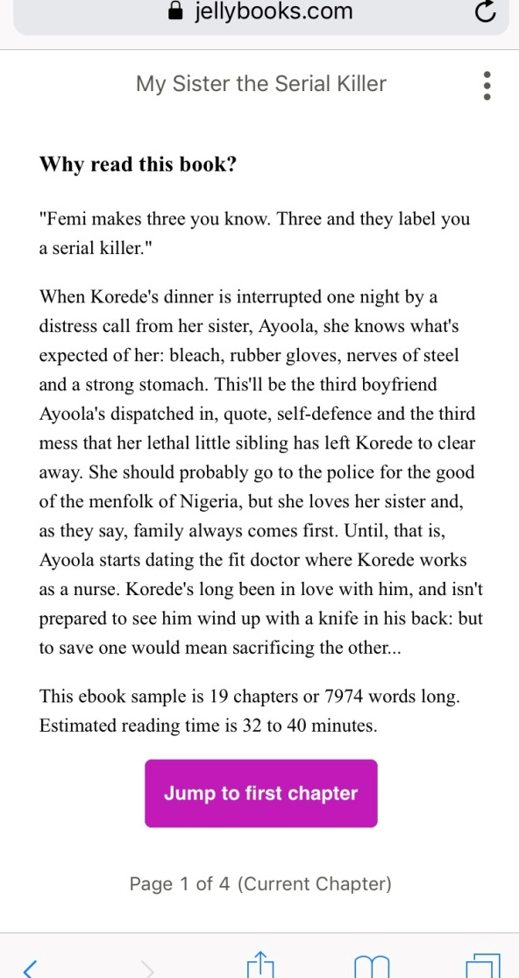
Keep them interested
attention is always fickle...

Slide 16
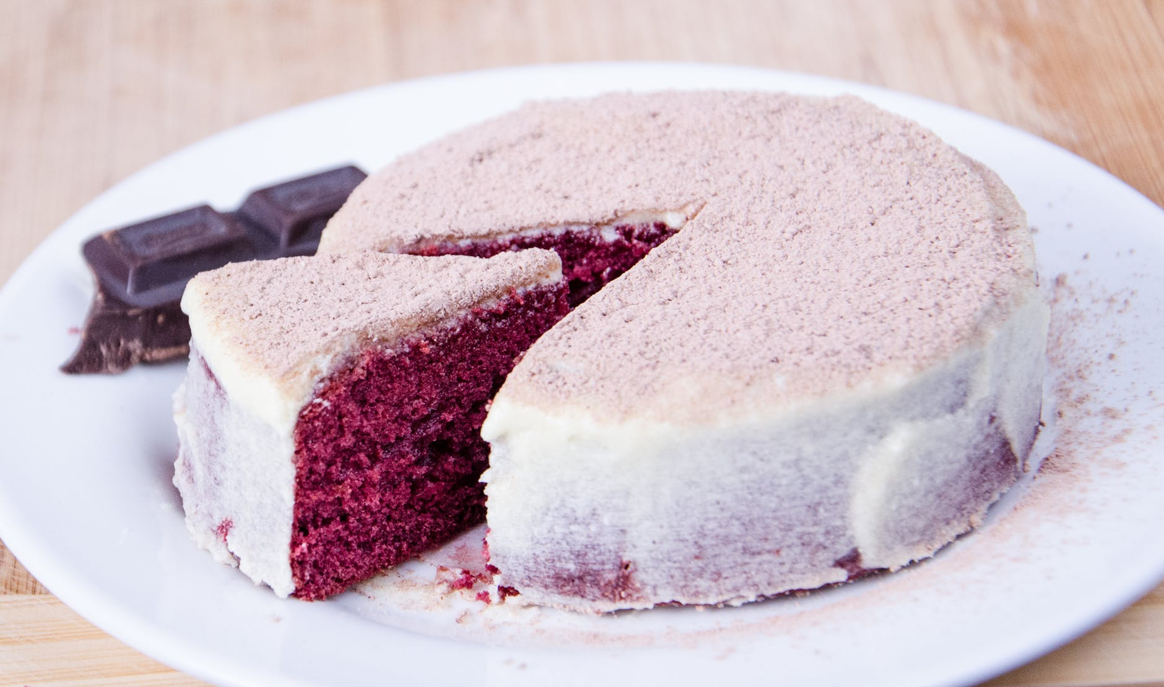
Size of sample
How large should an ebook sample be?
The cloud reader is a great platform for testing & measuring what size converts best...
Front matter
New book plate
Length of reading sample

Slide 17

Reinventing the Ebook Sample
Optimum length of an ebook sample
Increasing engagement (reading time)
Maximizing conversion to purchase
Stimulating sharing
(word of mouth)
Data capture within Cloud Reader + Jellybooks analytics allows us to optimize engagement and discovery paths and reinvent the (e)book sample experience

Slide 18

beyond the novel...

Slide 19

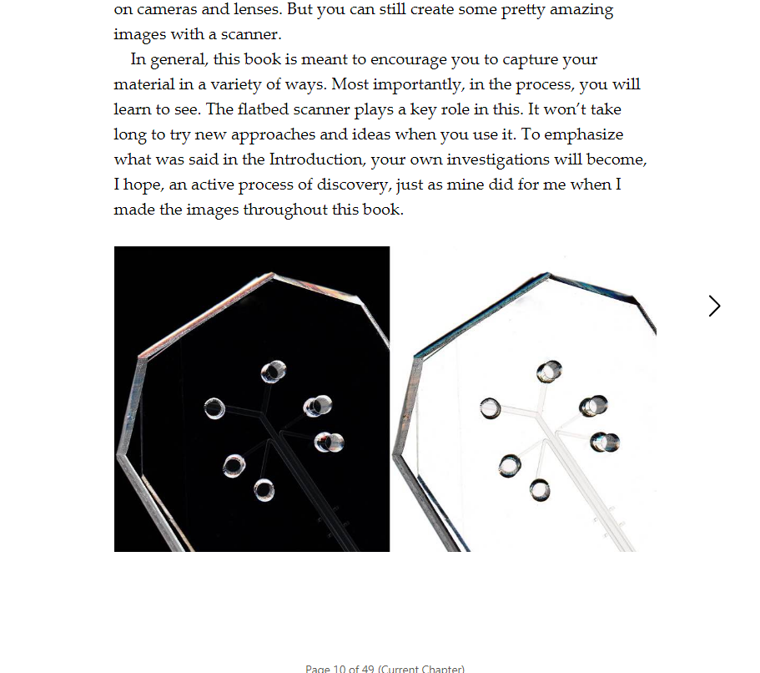
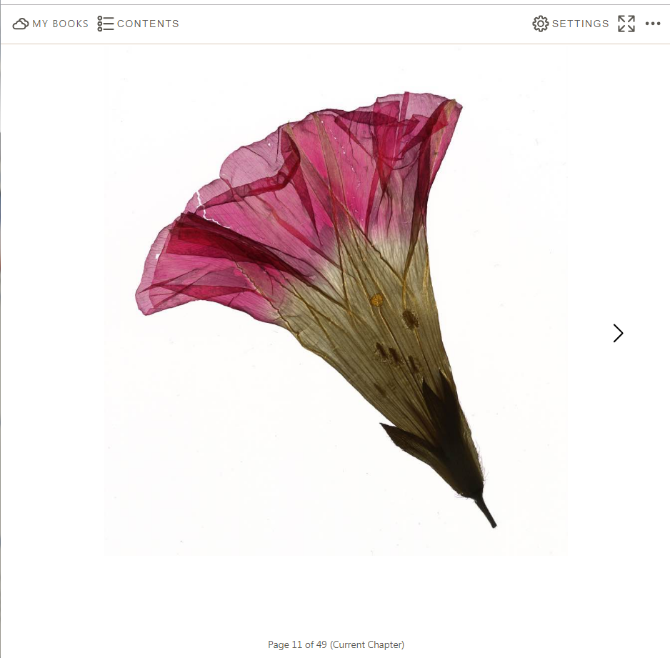
STM and Academic Books
MIT Press: jbks.co/science-and-engineering

Slide 20



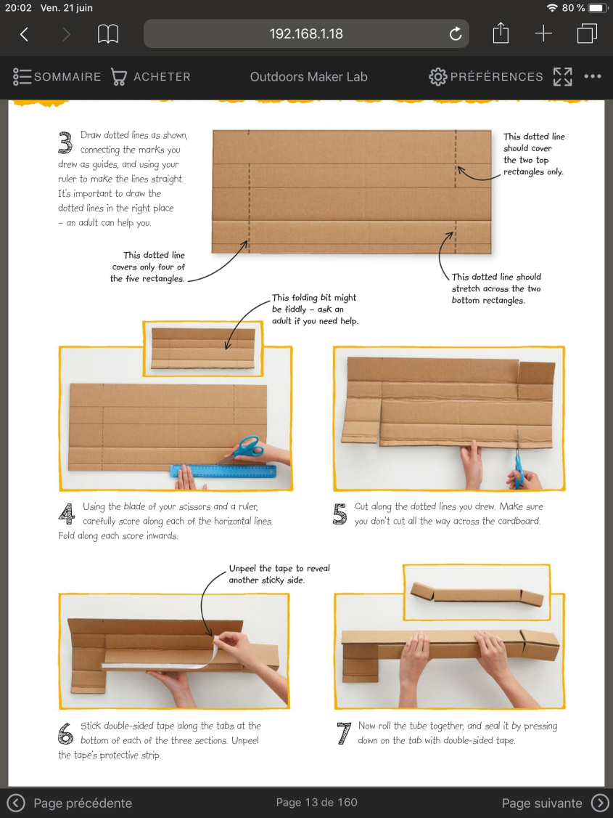
Fixed Layout
http://www.jellybooks.com
Children’s books
Cook books
Highly illustrated books
Comics/bande dessinée

Slide 21

Technology behind the
Jellybooks Cloud Reader

Slide 22

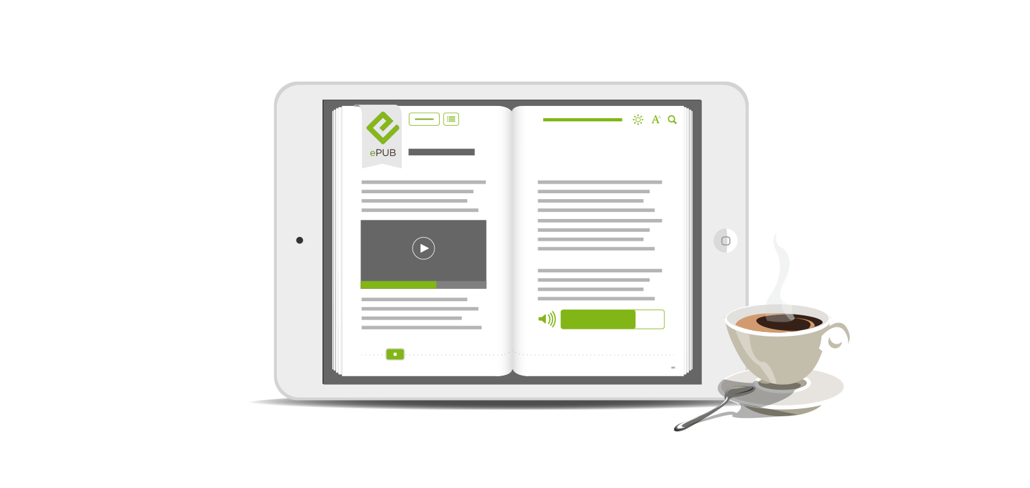
Readium 2
new possibilities
new opportunities
new possibilities
new opportunities
Our starting Point was the code base for the Simply E app developed by Amy Slagle/New York Public Library (NYPL).

Slide 23




Architecture - Jellybooks Cloud Reader
Client Device
(any browser capable gadget)
R2 - Navigator
Personalisation
(dynamic injects
personalised intro and buy pages)
Jellybooks Servers
(high availability architecture)
R2- Streamer
ebook samples
prepared from ePub 2 or ePub 3 files
and resources streamed on demand

Slide 24






Team slide?
Jellybooks Readium Team
Jiminy Panoz
R2 - navigator
Jeff Abrahamson
R2 - analytics
Andy Roberts
R2 - streamer

Slide 25





Adoption (first half of 2019)

Slide 26

















Adoption (H2-2019)

Slide 27

Cloud Reader – How is it being used? this is a commercial service for publishers
B2C
B2B
Social Media Marketing
Optimizing paid media campaigns
Driving Sales and pre-orders
E-Mail Marketing
Better user experience
Quantifying discovery paths
In-book marketing
stimulating word-of-mouth
measuring virality title by title
Maximizing engagement
Publisher’s Homepage
Measuring impact
Sales Catalogue
alternative to pdf + issuu
measure client engagement
Edelweiss, VLB-Tix
more cost-effective
smart permissions
Influencer Marketing
drive sales quantitatively
measure effectiveness
Inspection Copies
Tailoring experience
Measuring client interaction

Slide 28

Readium Cloud Reader
new possibilities
new opportunities

Slide 29

Readium in the Cloud
be data-smart!
contact me at
andrew@jellybooks.com

