Slide 1
allvit – Norwegian platform for digital academic text books
by Bokbasen AS
Ketil Stadskleiv, CTO Bokbasen AS
Digital Publishing Summit 2019

Slide 2
Why allvit?
Currently there are very few digital academic text books in Norwegian
No digital alternative for students that have Norwegian titles on their curriculum
International content is dominated by the large actors
Push from Academic libraries and Ministry of Education to digitalize higher education
No web-platform for eBooks in Norway, and no real support for advanced EPUB3 (native nor web). Retailer’s platforms not suitable for studying.

Slide 3
Bokbasen’s position to build allvit
Owned by the largest publishers
But open for all on equal commercial terms
Active in international forums related to digital publishing and supply chain standards
CEO Bente Franck-Sætervoll is on the board for EDRLab and Readium
Our Product Manager for Metadata is chair of Editeur’s ONIX committee and active member in the Thema committee
CTO, Ketil Stadskleiv is member of the Editeur’s EDItX steering committee
Active in national committees for catalogisation with the National Library
Bokbasen owns (and builds) the main metadata database for Norwegian publishers, retailers and libraries
Is the distribution central for all eBooks and digital audio books
So we have the files for all publications on our platform
Has the largest backend system for lending management of eBooks and digital audio books to libraries

Slide 4
Allvit – Business model
We are NOT a retailer
All transactions are formally between publisher and consumer/library
Allvit is the the platform that enables the transaction and where the user consumes the product
Direct sales to student
Life long licenses
Also time limited licenses (6, 12 months)
Library sales
Separate platform for libraries to buy licenses
Flexible (too flexible?) licensing models
1 year, lifetime, packages, pay per loan
When a library buys a license, the product is made available for the student for free through allvit

Slide 5
Building allvit – selecting the first platform
The publishers needed allvit to
Be accessible
Support lending from libraries, buying and renting
Support PDF (significant backlog), EPUB 2/3
Be a platform where students can work, comment and share information
Platform for future business models (subscriptions??)
Satisfactory piracy protection
Why a web platform?
Only capacity to build for one platform in phase 1
We had a theory that desktop/browser is the dominant platform for study work, confirmed through survey
Notes:
90% of respondents said that desktop was their first choice for studying using digital resources

Slide 6
Allvit – How to build the platform
Build an end-to-end ecosystem harvesting value from our existing services and the strength that we have both metadata and eBook files inhouse
Our link to Readium and EDRLab meant that it was natural to look into R2 for web
Put together a team to do a POC in August 2019, starting to see how the ecosystem could look like and how the reader could work
Decided on a technology stack that seems to match requirements, existing skills and future needs well
Put up a team consisting of
2 full stack developers inhouse
External UX company (UX, graphical design)
Aferdita Muriqi as lead on the r2 reader implementation

Slide 7
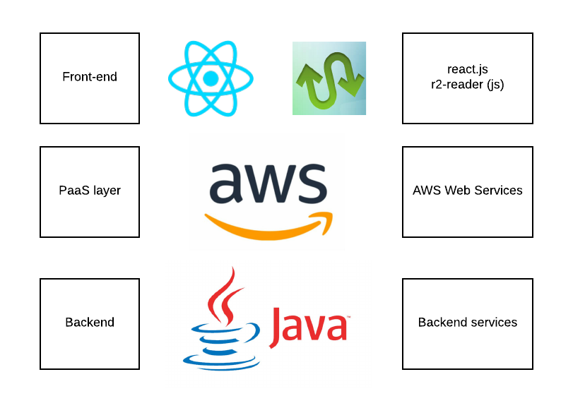
Allvit – Technology stack

Slide 8
What are we building in allvit?
Online discovery platform
Processes for buying, payments (cards/mobile), and library lending
Full text search engine for all eBooks
Online reader for PDF
Online reader for EPUB
Readers must have the ability to:
Store bookmarks
Store highlights
Store comments
Reader settings (dark mode, fonts, size)
Share highlights and comments with other users

Slide 9
What are we building in allvit? – full text search
Allvit gives you the opportunity to do full text search across the entire catalogue as a part of the discovery process
The discovery here is a bi-product of that we needed full text search in the backend to support search in individual books (as we do not have the entire book in the browser)

Slide 10
How do we do full text?
We index the plain text of EPUBs and PDF during ingestion
We found that got best results with small chunks (documents)
Ingesting 12000 books gives about 30M searchable documents
Unzip EPUB and extract html files
Strip away markup and split into small chunks
Add chunks to search engine

Slide 11
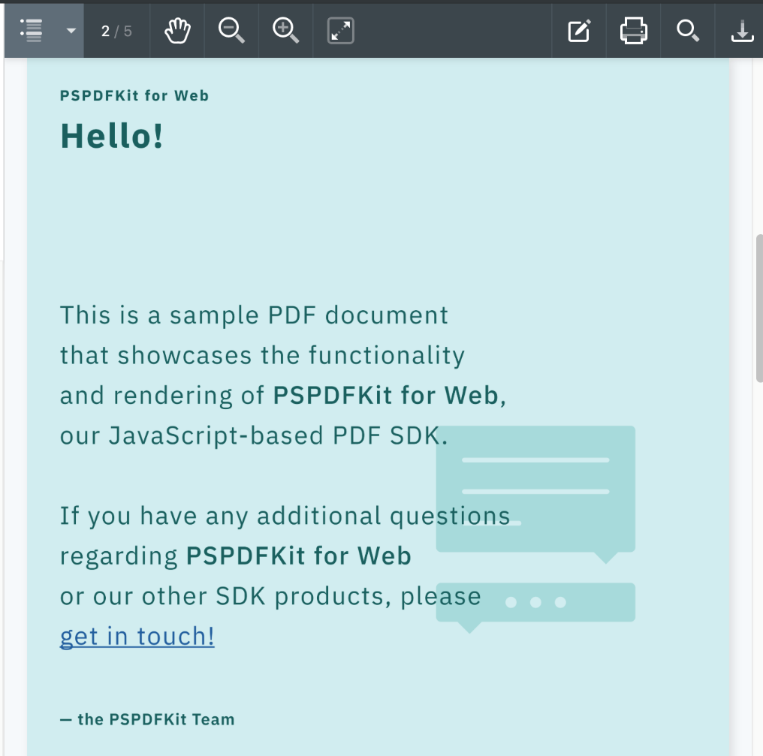
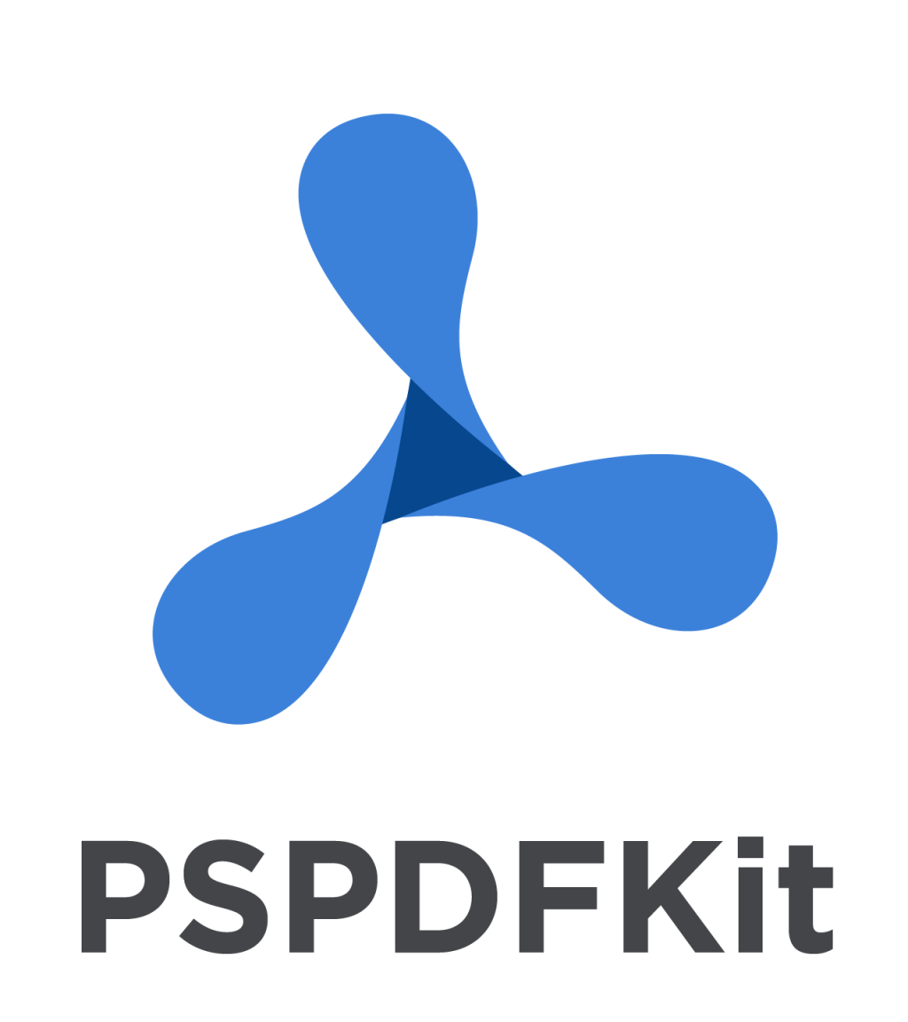
Online reader - PDF
Based om commercial product pspdfkit
Both server and JS-client with out of the box support for commenting and annotations
Benefit: Fast way of delivering pdf-support, which is crucial for start-up as a large portion of backlog is pdf
Challenge: Ensure a consistent user experience across EPUB and PDF

Slide 12
R2 reader for web – key challenges (subjective)
Not a real component, always implemented as an integral part of an app, instead of a reusable component.
Consequence is:
Even small changes or even UX modifications causes changes to the r2 source code
Making the reader hard to reuse across multiple applications
Making it hard to have r2 reader as an active open source project
To fix this for allvit we needed:
Clear APIs how to the application should interact with the reader
Handling the reader as a dependency with versioning integrated into a larger build process

Slide 13
R2 – reader what have we done
Features
Highlights
Timeline
Locator
Usage of Webpub manifest
Single iframe
Bookmarks
User settings
Architecture
Added APIs for the interaction between the allvit react app and the reader
Setup a separate build pipeline for the reader, producing an NPM package which is then a dependency in allvit
UI
Moved all UI out of the reader into react.js, and then use APIs to interact with the reader
Benefits: reusable components across the application and also between EPUB and PDF reader
Consistent look and feel, using the same design system as the application

Slide 14
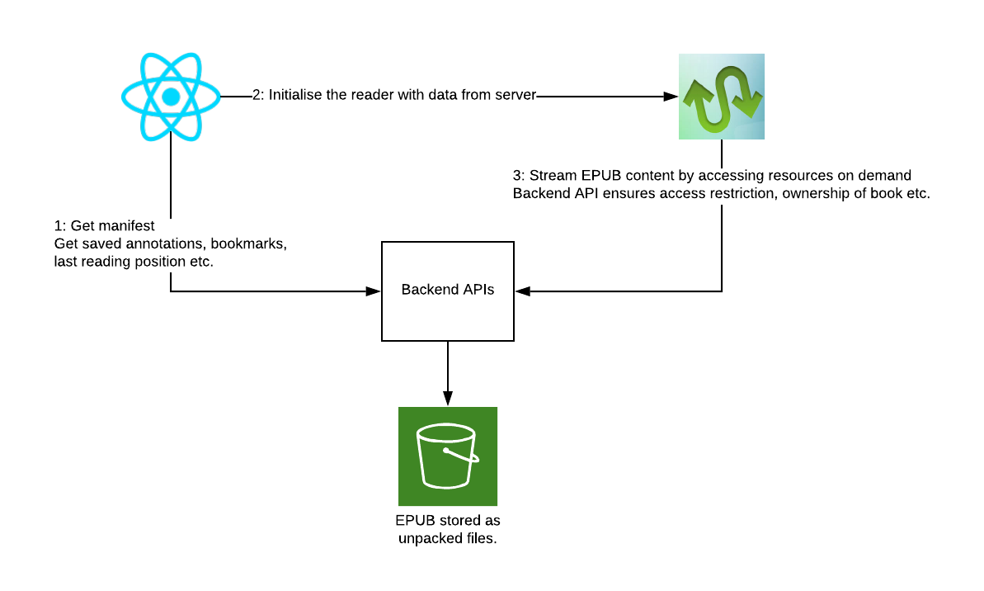
Reader implementation

Slide 15
Demo and stuff

Slide 16
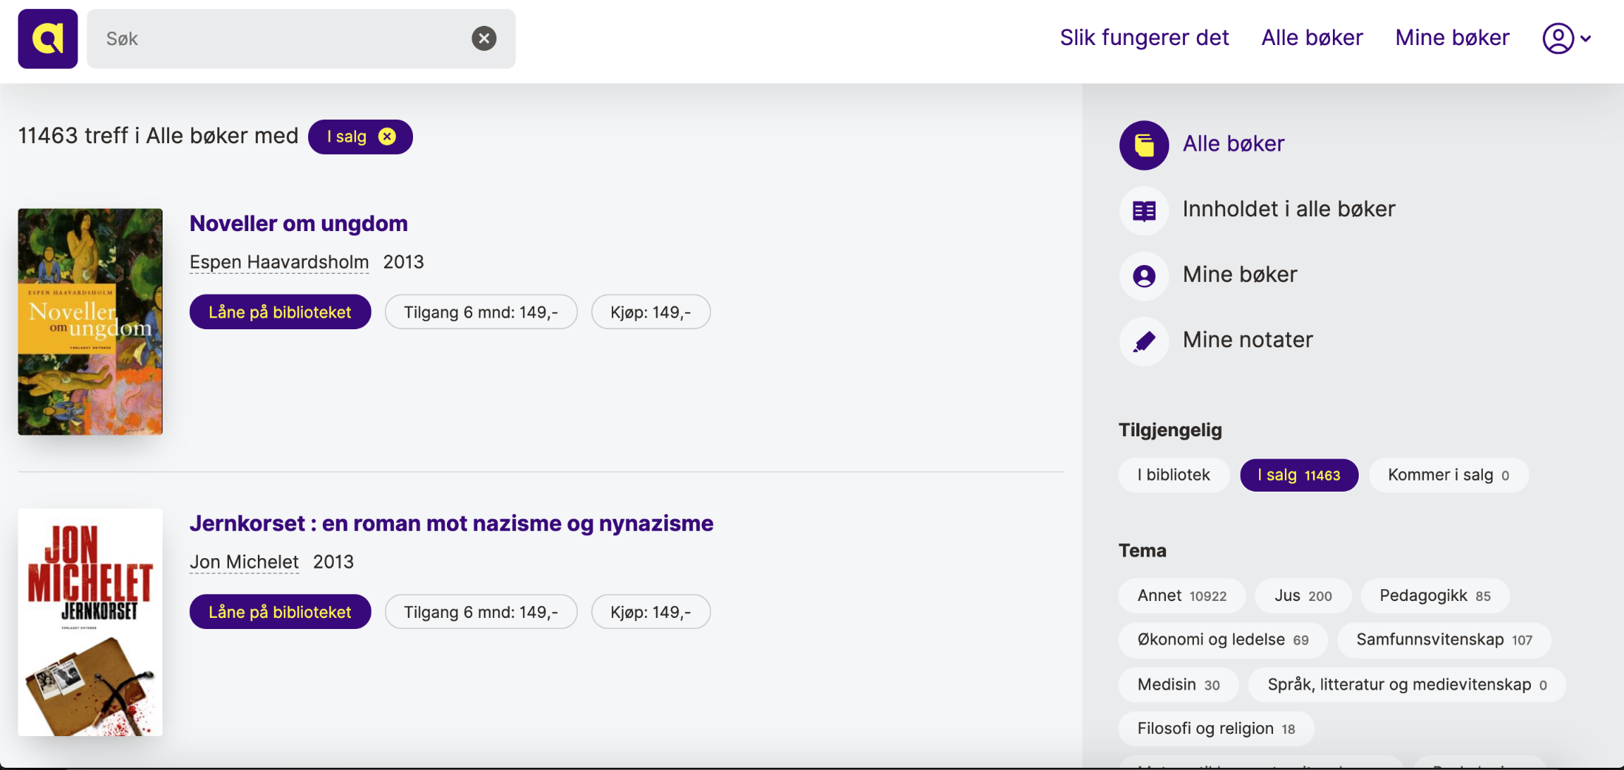
allvit

Slide 17
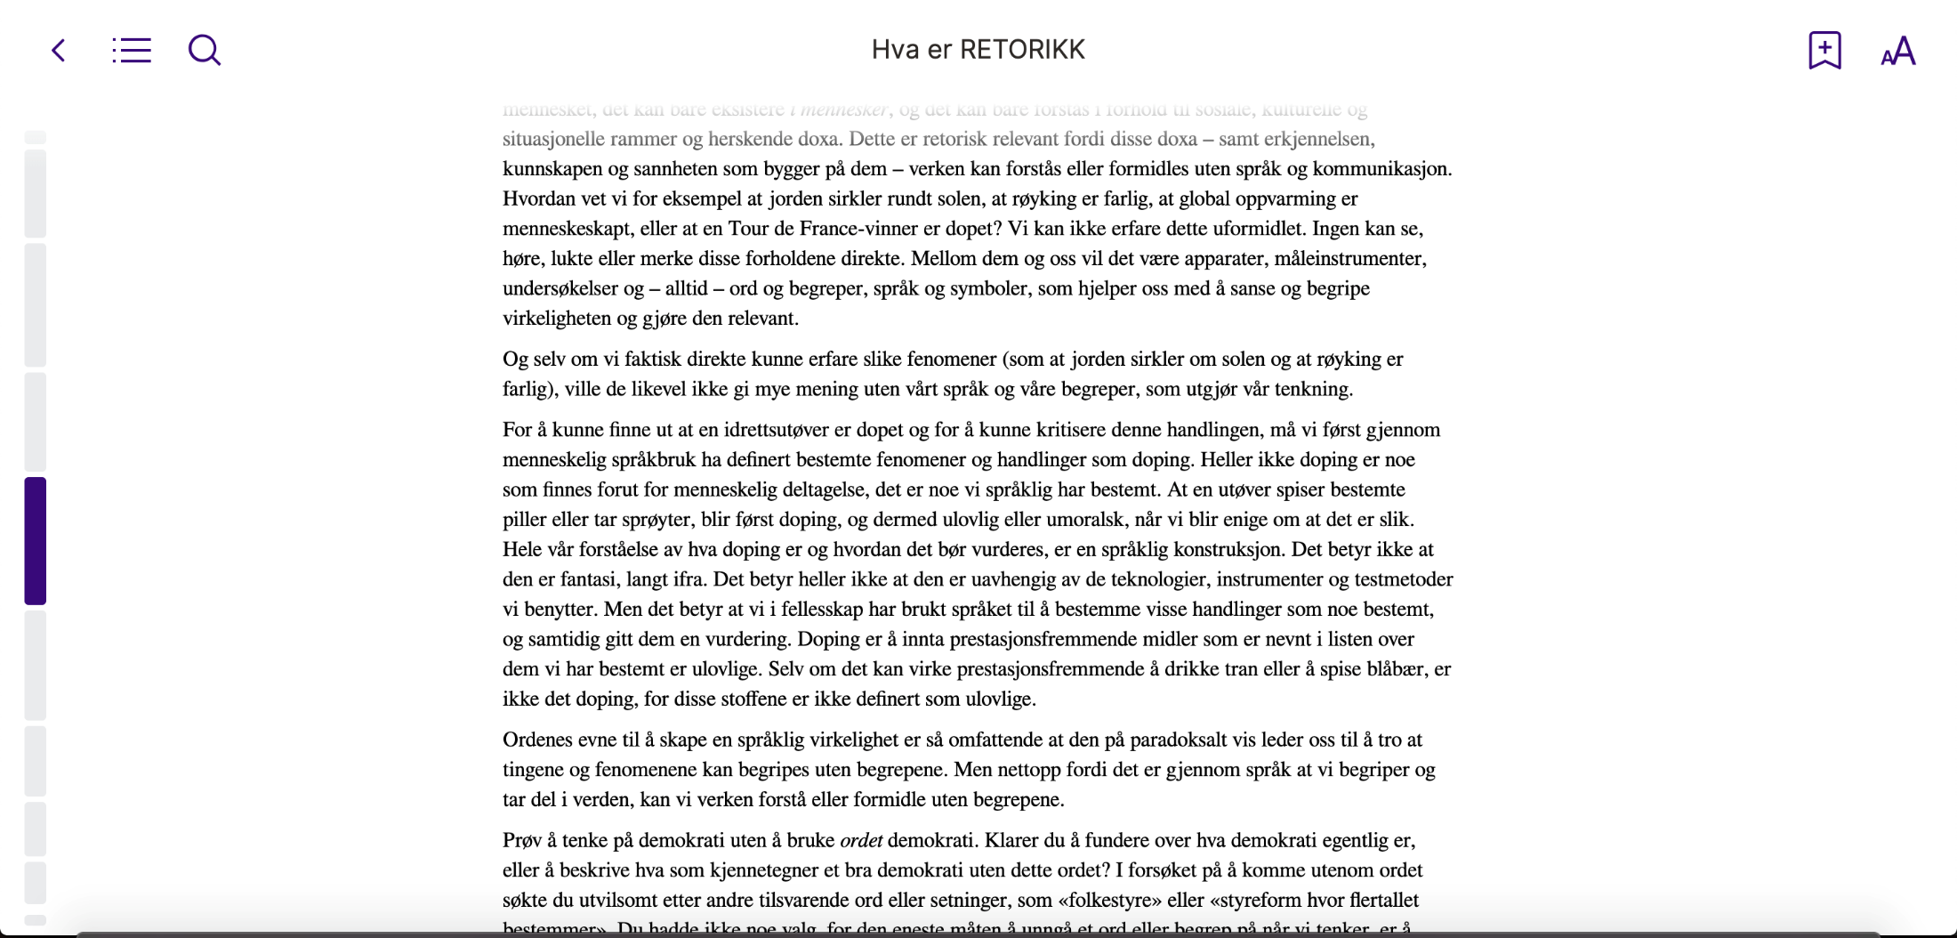
allvit

Slide 18
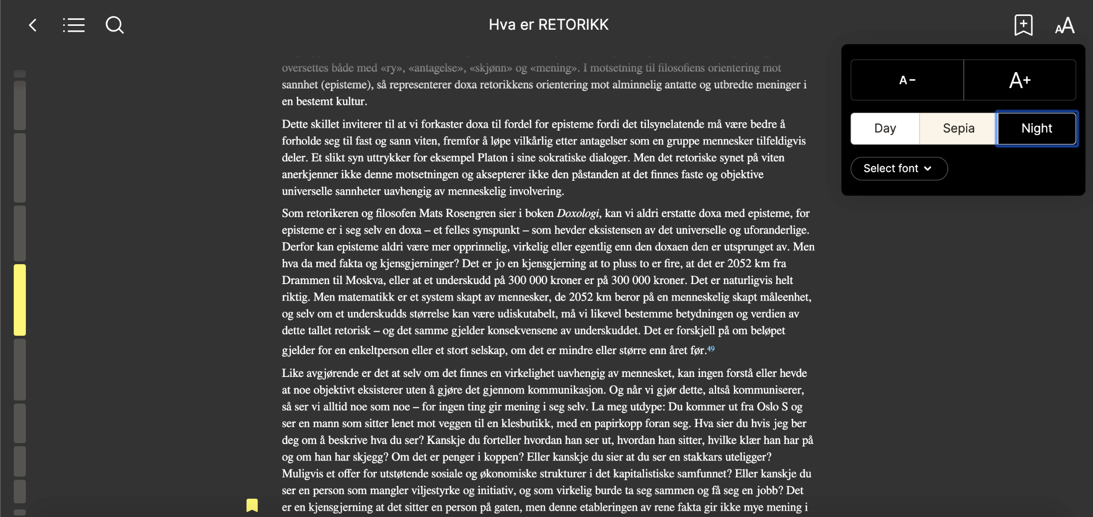
allvit

Slide 19
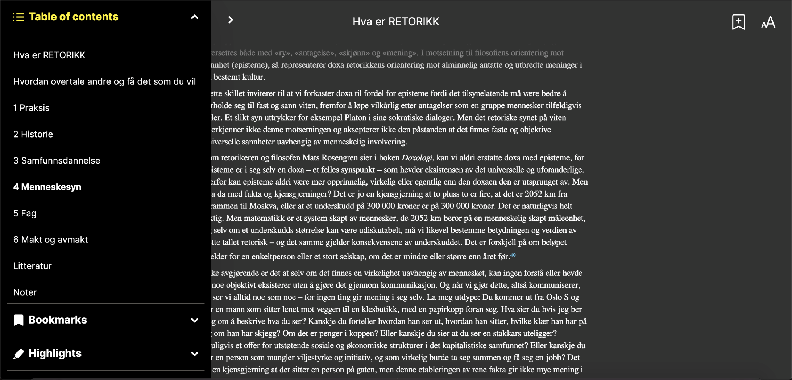
allvit

Slide 20
Allvit – annotations video

Slide 21
Allvit - The future
Launching for students in August 2019
Start native projects based on R2 native SDKs (release January 2020)
This will use LCP for DRM, first initiative to start using LCP in Norway and a future potential for retailers
Expand market for platform to public libraries on a separate brand
Increases potential use base to 2M
R2 improvements can be contributed back to readium

