Slide 1
LCP deployment mid 2019

Slide 2
Facts
A DRM is required for e-lending.
01
Many publishers also require DRM protection for retail use cases.
02
The Adobe DRM is failing the industry; not updated, not user friendly, not accessible, costly.
03
Current alternatives are closed solutions (ex. Amazon, Apple, Google, Overdrive, Kobo).
04

Slide 3
LCP, a non-proprietary Solution
A simple and inexpensive rights management solution:
Good protection
No cost per transaction
Vendor-neutral, interoperable.
No personal data involved (GDPR)
No issue for visually impaired people

Slide 4
Other pros
Suitable for all types of publications (fixed layout, audiobooks, comics, in epub or pdf)
Adapted to any types of diffusion (loan in particular, but also subscription)
No strict limitation on the number of devices used in a license lifetime, but flexible limits
Public specifications (99%) & open source software
Certification of interoperability
Will become an ISO standard

Slide 5
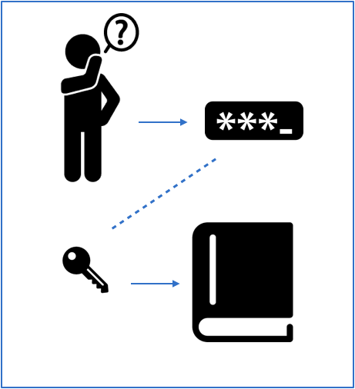
Simple for users
Choose an ebook
Load it, open it
Enter your LCP passphrase once (if it is not already cached)
Read
... and you can share the passphrase with your family

Slide 6
Adoption in France and Belgium
By publishing groups -> Hachette Livre, Editis, Madrigall, Media Participations, Albin Michel …
By e-distributors -> TEA, EDEN, Numilog, Immatériel, Interforum, ePagine
By Dilicom, in charge of "Prêt Numérique en Bibliothèque"
By library portals -> Cantook Station, Archimed ...
By booksellers -> TEA customers
By reading systems -> Baobab Reader, Lea Reader, TEA, Bookeen ...

Slide 7
Adoption in Europe
Germany: by The Onleihe / Divibib via TEA (*)
and by Tolino / Kobo e-readers
UK: by Firsty Group, on Glassboxx and Ulverscroft (library)
Sweden: by Axiell Media, provider of library platforms
Norway: by Bokbasen, for the academic library market
Russia: by FBReader, a multi-platform reading app.

Slide 8
Adoption in Canada & USA
Canada:
Bibliopresto.ca will present the current deployment of LCP
The Canadian Electronic Library is now protecting fxl EPUBs on deslibris.ca with LCP.
USA:
Gantec Publishing will soon protect EPUBs on ebooks2go.com with LCP.
Could finally be implemented on the SimplyE reading app in 2019.

Slide 9
Adoption in Asia & Australia
China: the Shanghai Library is developing a new platform with LCP and Readium SDK apps
Hong Kong: Inspirata Publishing is integrating LCP in its ebook retail platform
Japan: Global Comics is adopting LCP for its new manga platform
Australia: Webqem is setting up a hosted platform for publishers and distributors

Slide 10
More to come

