Slide 1


Slide 2

eBook Platform Solutions

Slide 3


Slide 4

What we do
We design and build engaging, best-practice eBook store solutions, fully integrated with Digital Rights Managed (DRM) and delivered on desktop or mobile readers.

Slide 5
Our approach
Our approach is to become the customers trusted partner, developing just the right solution tailored to their needs.
eBooks strategy
Digital Rights Management
Shopping cart solutions
eBook readers
Readium LCP
Magento
webqem eBooks
Adobe
Shopify

Slide 6



















Some of our customers

Slide 7


Partnership

Slide 8

Out of the
box solution

Slide 9
How it works | Put simply

Slide 10

How it works | Put simply
Manage
Protect
Acquire
Consume
eBook Admin
LCP Server Hosting
eBook Store
Reader

Slide 11

Customer
Due to a last minute request from the customer we’re unable to name or speak about them.
Therefore we have disguised them.

Slide 12
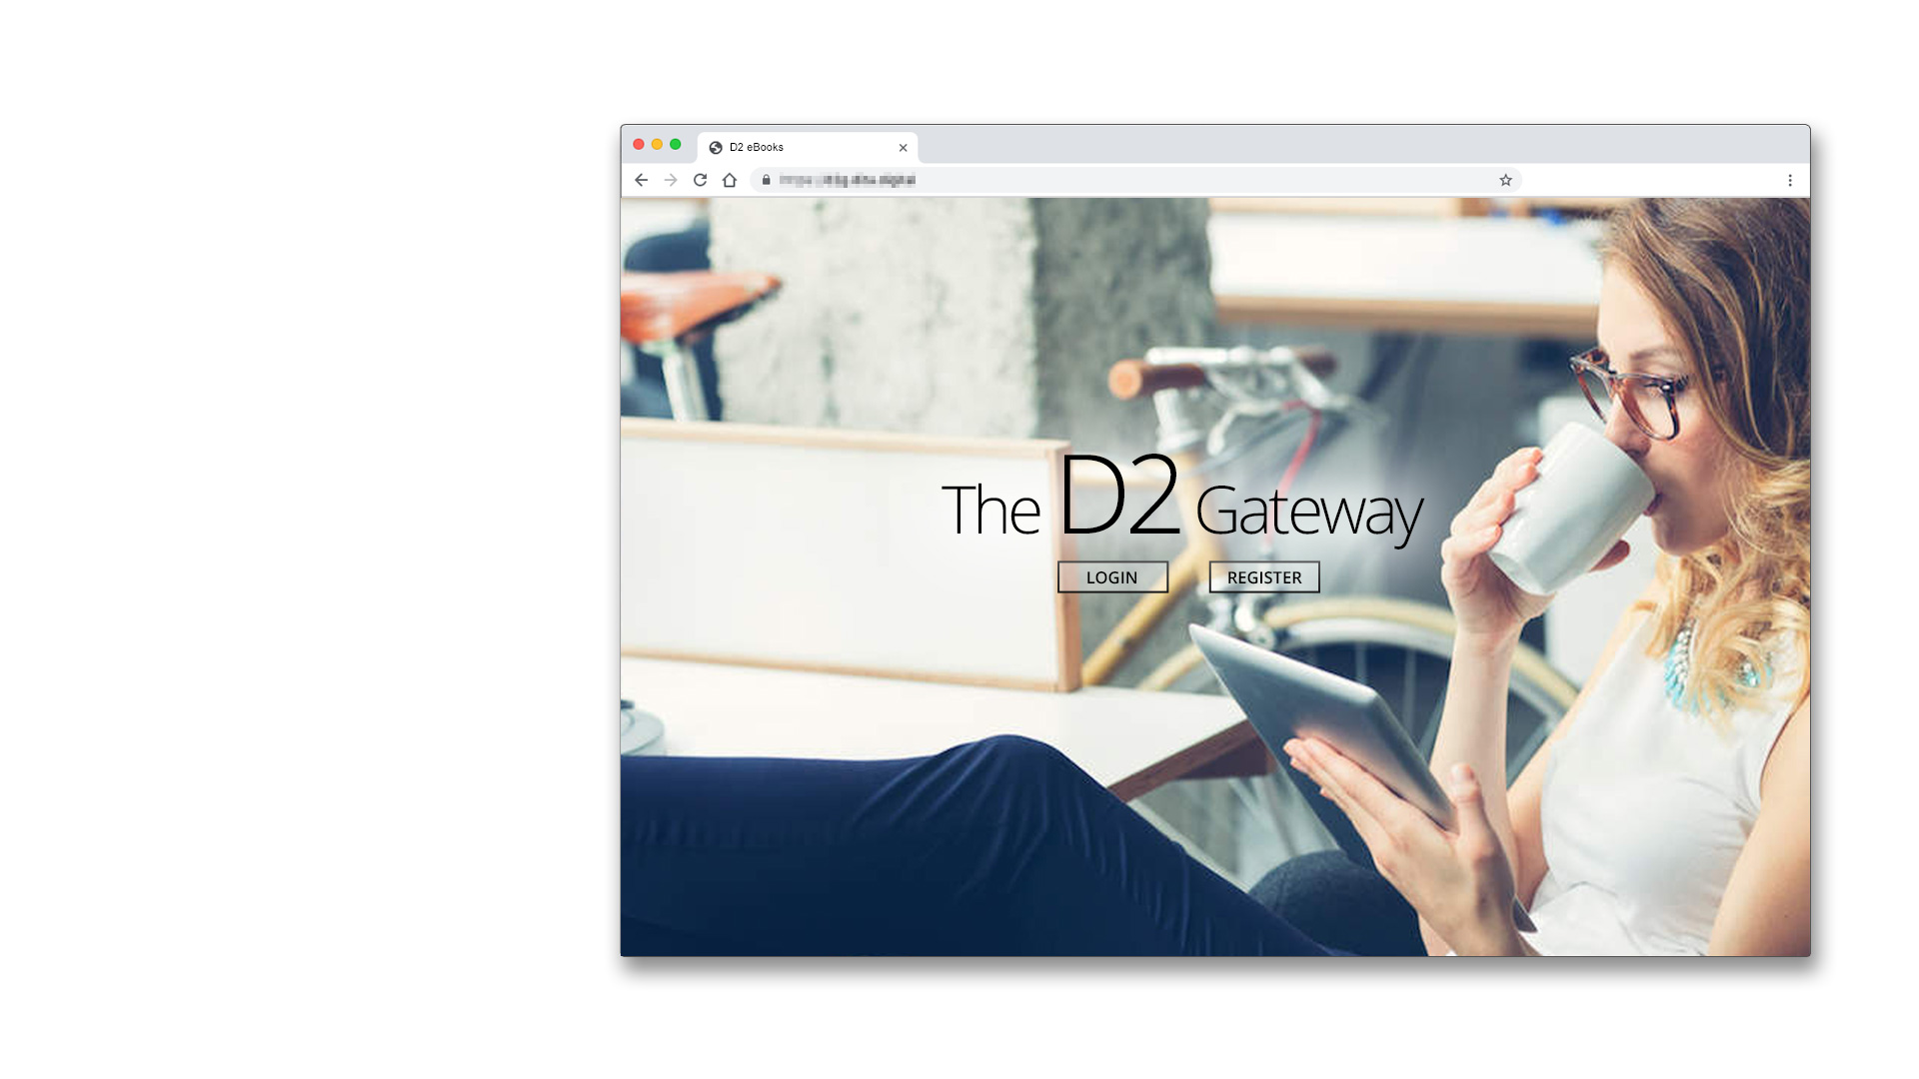
Manage
eBook Admin
Serves as the gateway to easily access and manage your ebooks
User management
Collection management
Book ingestion
LCP encryption

Slide 13
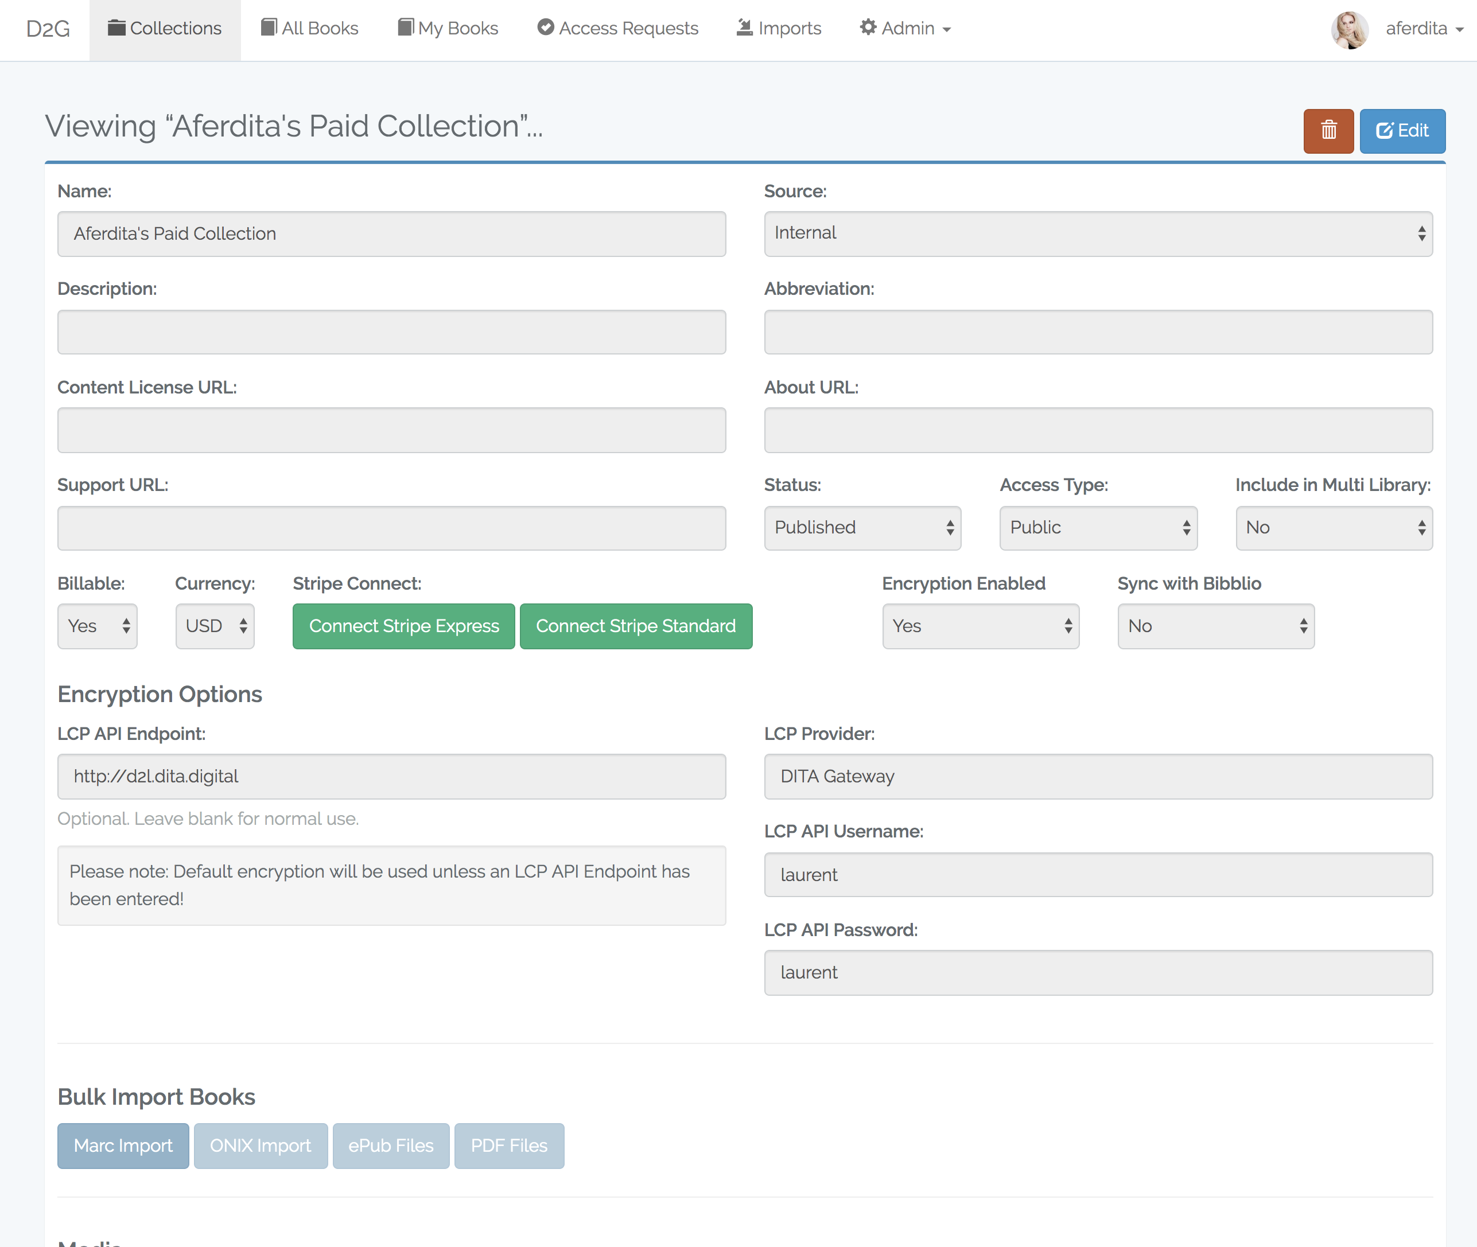
Manage
eBook Admin
Open, public and private collections
Book ingestion
Manage metadata
Link payment accounts*
Set up pricing*
* Optional
Need screenshots with books

Slide 14
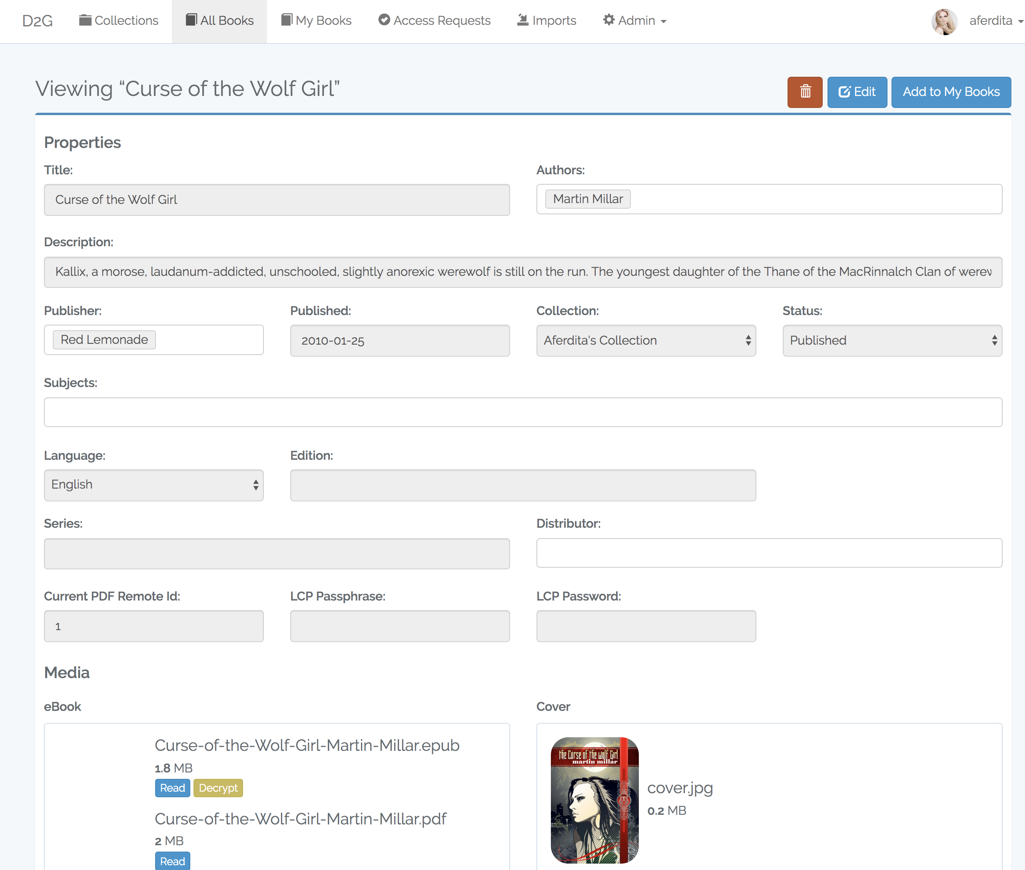
Manage
eBook Admin
Open, public and private collections
Book ingestion
Manage metadata
Link payment accounts*
Set up pricing*

Slide 15

Protect
LCP Server Hosting
Fully hosted and managed LCP Server
Spin up in a matter of hours
Twenty four hour monitoring
Dedicated servers
Tier 3 data center
Pre certified

Slide 16
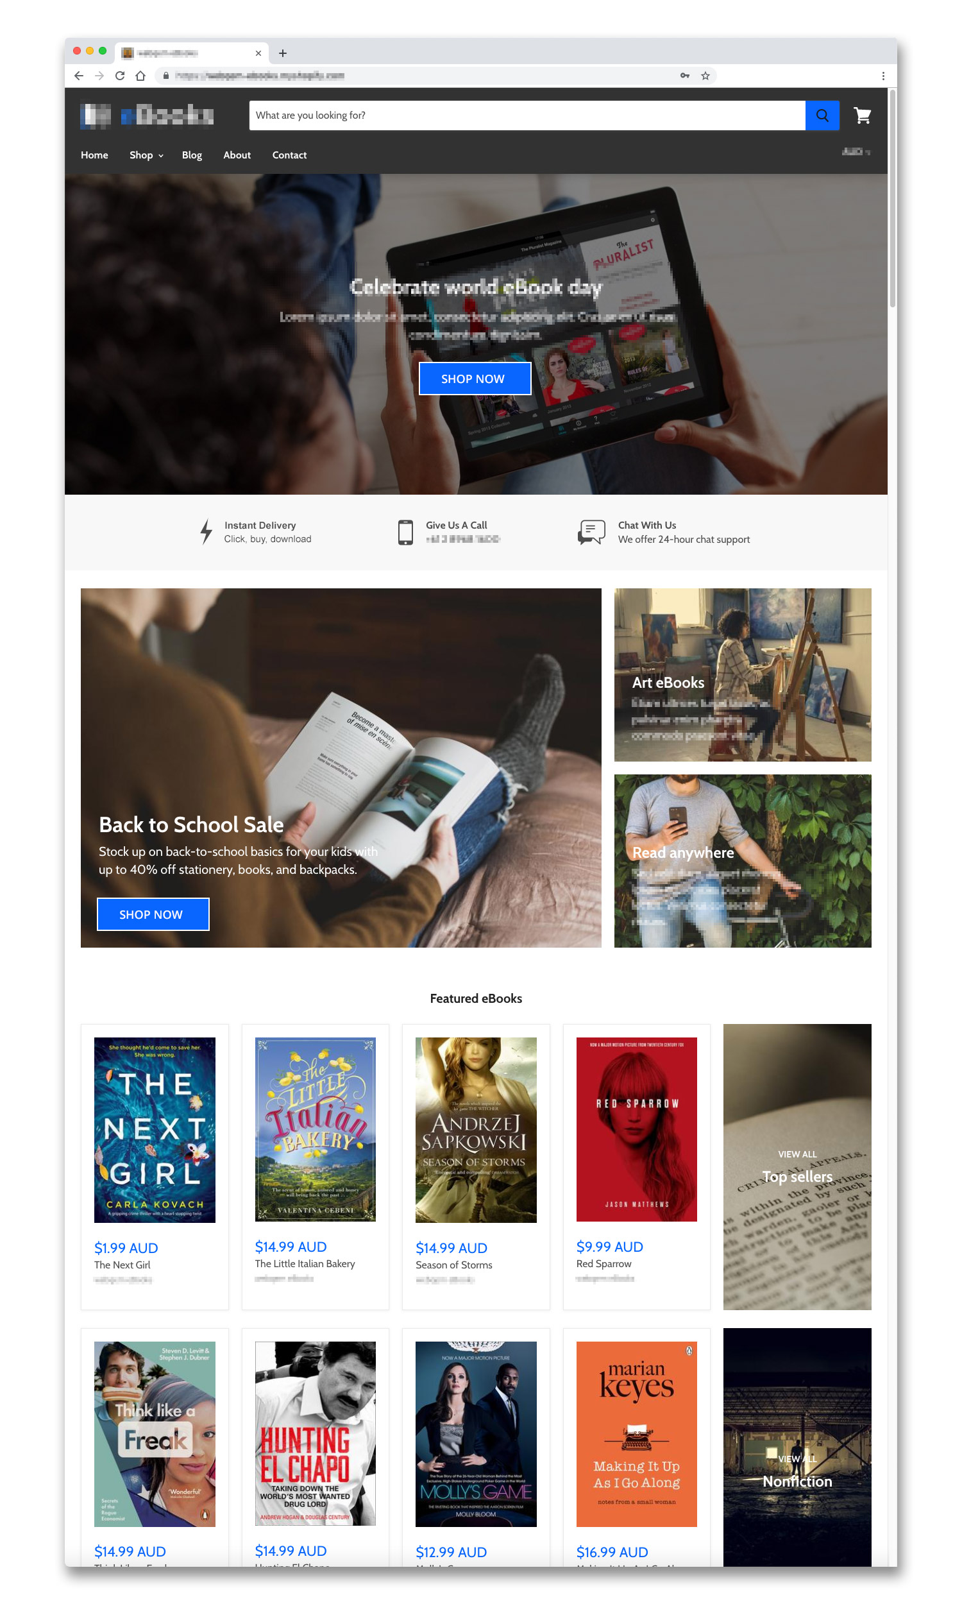
Acquire
eBook Store
Business 2 Consumer website, built in just four weeks.
White labeled solution
Built with Shopify
Fully hosted, 24/7 support
Site design & user experience
Search Engine Optimisation
Analytics & insights
6/24/19
16
Copyright © webqem | Commercial in confidence

Slide 17

Consume
Reader
DITA Reader
Custom branded white label reader
Access your catalog of content
eCommerce store integration
Support for both iOS & Android
Readium LCP

Slide 18
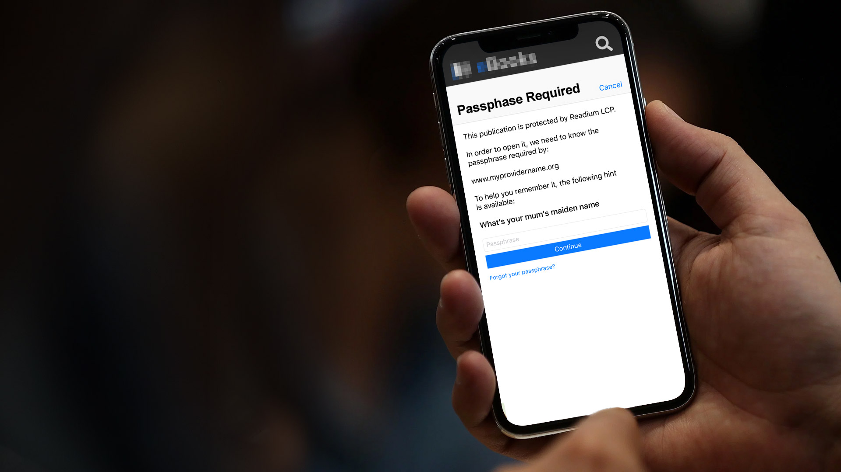
Consume
Reader
DITA Reader
Custom branded white label reader
Access your catalog of content
eCommerce store integration
Support for both iOS & Android
Readium LCP

Slide 19

Thank you
Name | Gavin Perry
Phone | +61 2 8968 1672
Mobile | +61 422 309 996
Email | gavin.perry@webqem.com

