Slide 1
Digital Visual Narratives

Slide 2
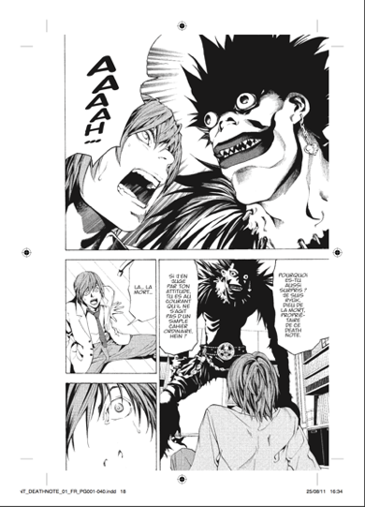
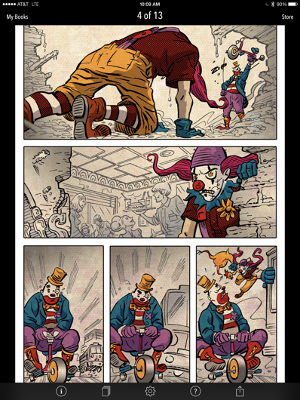
2 B €
500 M €
200 M €

Slide 3
Phallaina
Panama Al Brown

Slide 4
Constraints
Users: wide reading system support is required.
Reading systems developers: sufficient volume of content is required.
Publishers: low development costs are required.
To lower the costs: reduce the amount of technical people required between the artist and the reader.
To minimize technical assistance to authors: easy-to-use authoring tools are needed.

Slide 5
Our method
Collaborate
Bring together the actors of the book chain … collaboration is in our nature.
Standardize
Create a distribution standard (EPUB is not quite appropriate).
Open-source
create open-source authoring and reading tools.

