Slide 1
Florian Dupas (Kwalia) & Yoann Le Scoul (Pika)
June 26, 2019
Creating the First DiViNa, the Future of Digital Comics

Slide 2
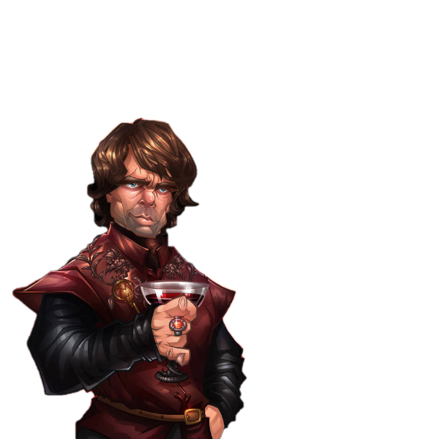
The Power of stories
“What unites people?
Armies? Gold? Flags?
Stories.
There’s nothing in the world more powerful than a good story.”
– Tyrion Lannister (Game of Thrones)
© Bing Ratnapala

Slide 3
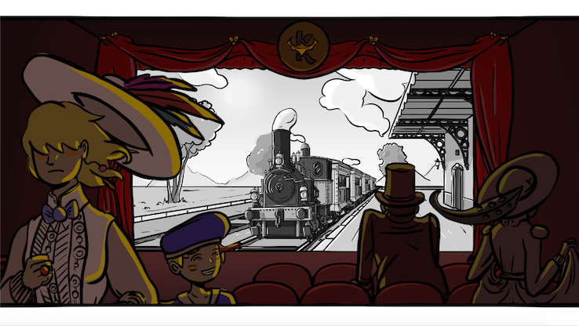
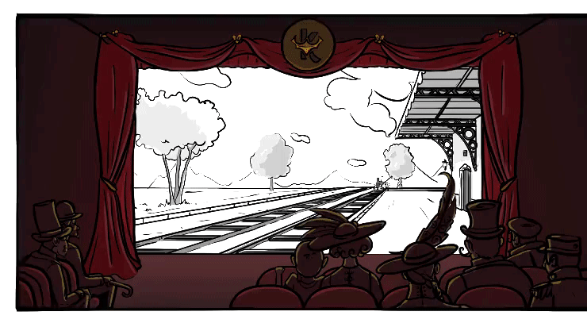
Kwalia’s Endeavor
Our mission: allow creators to leverage the power of digital tools to create better visual narratives

Slide 4
Giving Birth to the DiViNa Format
How can we all unite our efforts? By specifying a standard format for digital visual narratives
The promise of the DiViNa format
Editorial control
Cost reduction through industrialization
Durability
+ Multilingual publications, digital library loans…

Slide 5
The BDCoMa’s Workflow
Study works labeled as digital comics
List use cases (features)
Define functional concepts
Write DiViNa specifications

Slide 6
Launching a Pilot Project
Different objectives behind a common goal:
EDRLab: showcase the BDCoMa WG’s work
Pika Edition’s H2T (Hachette Group): demonstrate interest for innovation and working with authors
Yoann Le Scoul (author): experiment with a new form of digital creation
Kwalia: build an authoring tool with creator feedback

Slide 7
Scope of the work
The 1st example → 4 different items
A publication (Pika/Yoann)
The specifications of the DiViNa format (BDCoMa WG)
A reading engine – and a test app (Kwalia)
Ideally, an authoring tool (Kwalia)
Hence a variety of points of view to consider:
Storytelling + Art + Technology + UX/UI Design + …

Slide 8
Process: back-and-forth between Tech & Art
Tech/UX
Common language
Art/Creation
Dec.
Meeting #1: objectives
Story-boarding
Jan.
Meeting #2: tool prototype and storyboard (possibilities)
Voca. Definition
Feb.
Meeting #3: from wishlist to list of effects (decisions)
Tool Dev.
Work on first 30%
Mar.
Meeting #4 to #7: editing the first 30% of the story, with continuous improvement of content, format and tools
Apr.
Tool Improv.
Work on following 70%
May
June

Slide 13
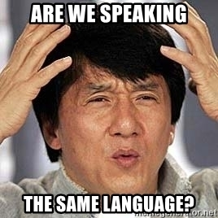
Lessons Learned – 1. Vocabulary
“But what IS a page, really? And what IS a publication?”
– Everyone in the WG (at some point)

Slide 14
Lessons Learned – 1. Vocabulary
The lesson: not speaking the same language can make you lose a lot of time
Recommendations
Define a shared vocabulary
Allow the introduction of words that make things easier

Slide 15
Lessons Learned – 2. Limitations
“The enemy of art is the absence of limitations”
– Orson Welles

Slide 16
Lessons Learned – 2. Limitations
The lesson: without limitations, things can easily get out of hand
Recommendations
Start with why – and continue with why too!
Also, be ready to say no

Slide 17
Lessons Learned – 3. UX
“They may forget what you said or did – but they will never forget how you made them feel”

Slide 18
Lessons Learned – 3. UX
The lesson: UX is key at every level
Recommendation: implement features one by one by order of increasing UX complexity, not technical complexity!

Slide 19
Lessons Learned – 4. Experimenting
To be honest, we don’t always know what we are doing… And that’s ok!
Recommendation: make experimenting easy

Slide 20
The BDCoMa’s Updated Workflow
Study works labeled as digital comics
List use cases (features)
Define functional concepts
Write DiViNa specifications
Work on a first example

Slide 21
Impact on The BDCOMA WG’s WORK
Example of a major evolution: how to deal with animated transitions?
Allow sequences?
Allow video?
Final decision: create a dedicated effect (layer entry animations)

Slide 22
The DiVINa Format At THIS STAGE
 | Level 0 (simple flow) | Level 1 (markers) | Level 2 (layers)
Tappable stories | Overflow Fit Alternate resources | Page transitions Guided navigation | Layer entry animations
Scrollable stories |  | Snap points | Parallax

Slide 23
Next Steps
Publication: finish content and improve with effects
DiViNa format: specify and document
Reading engine: publish a first version
Authoring tool: clean code, set up UI and connect

Slide 24
Thank You
Now please feel free to ask any questions

