Slide 1
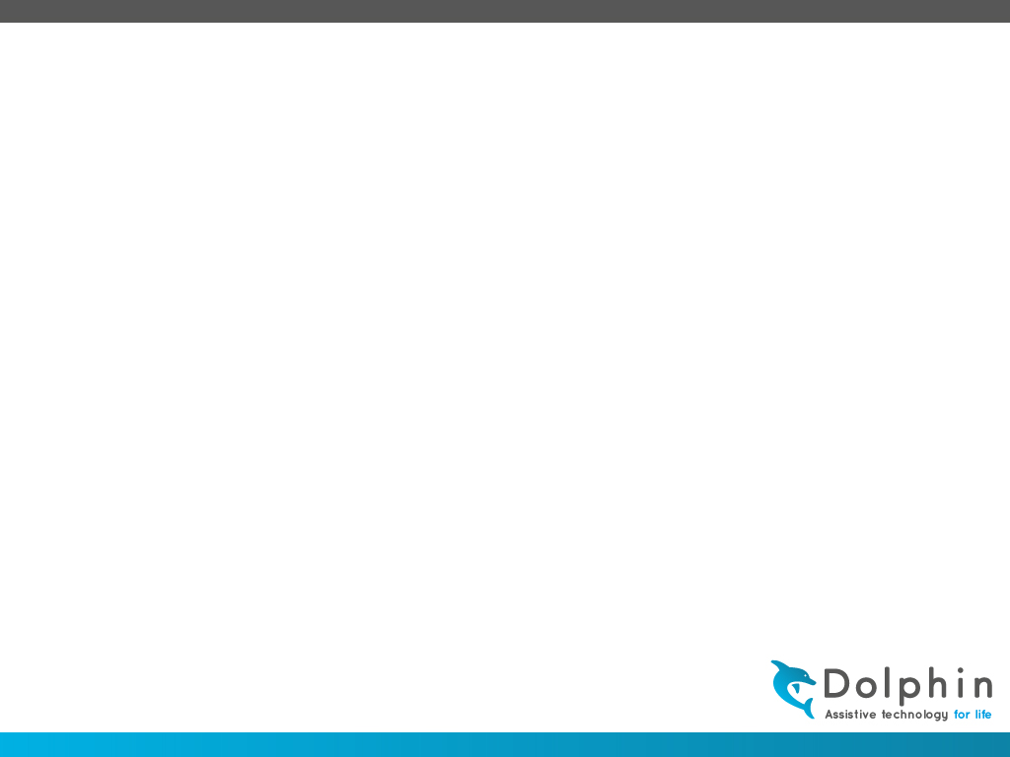
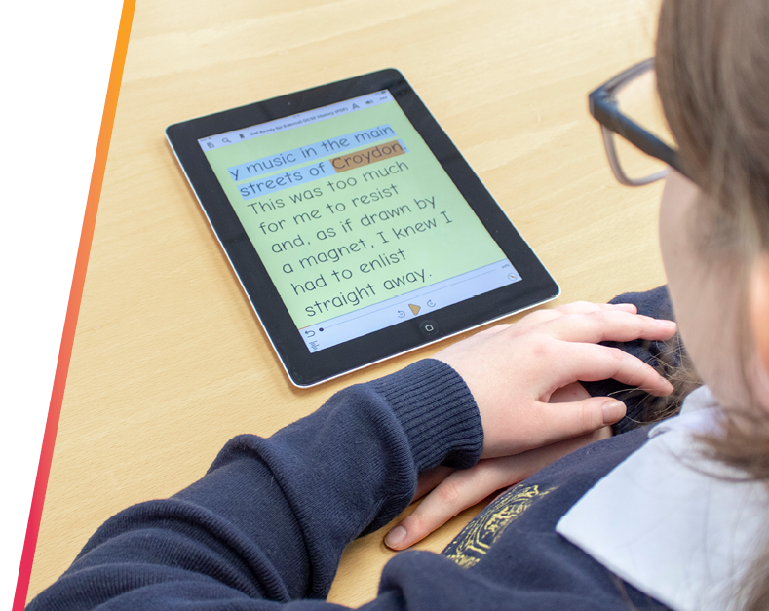

Accessible reading with Dolphin EasyReader
Presented By:
Mattias Karlsson – mattias.karlsson@yourdolphin.com

Slide 2
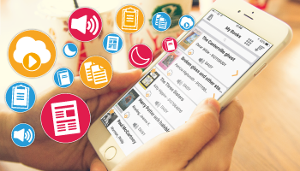
About EasyReader
Started 1994
Reading solution for people with dyslexia, low vision and blindness
Accessibility and ease of use with reading features in focus
Compatible with VoiceOver, Talkback, screen readers and with leading Braille displays
Listen and read with synchronised text and audio
Choose colours, text size and highlights to suit the readers preferences
Quick and easy access to relevant content

Slide 3
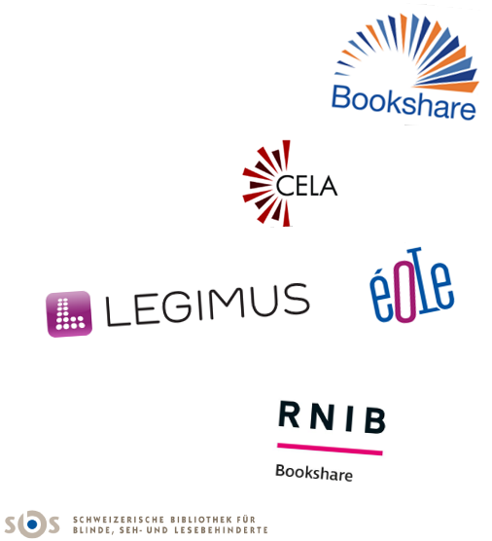


Connected libraries
More than 30 online libraries of accessible content

Slide 4

EPUB support
Focus on connected online libraries
EPUB 2
EPUB 3
  Sub set of EPUB 3
  Text-only content
  Reflow content
  Navigation and limited formatting support
Accessibility evaluation and testing on epubtest.org
  Read Aloud 100%
  Non-visual Reading 92,9%
  Visual Adjustments 75%

Slide 5
EPUB 3 in the future
Test results are OK, but we can do better
Libraries move to DAISY to EPUB 3
New features:
  Media Overlays
  Skippability
  SVG images
  MathML
  More…
Available later this year and onwards

Slide 6




Available platforms

Slide 7

EasyReader Share
A cloud solution for distributing files into the EasyReader platforms.
Delivery to a group of users or individuals
Designed to be as simple as possible
Focus on accessibility
File format support:
  Word DOCX
  PDF files
  PowerPoint
  EPUB
  More…
In Beta now, for release later this year

Slide 8
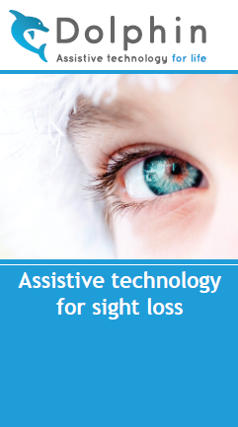
Thank you…
for taking part of today’s session.
Email:
mattias.Karlsson@yourdolphin.com
www.YourDolphin.com/EasyReader-app

